Slide 1
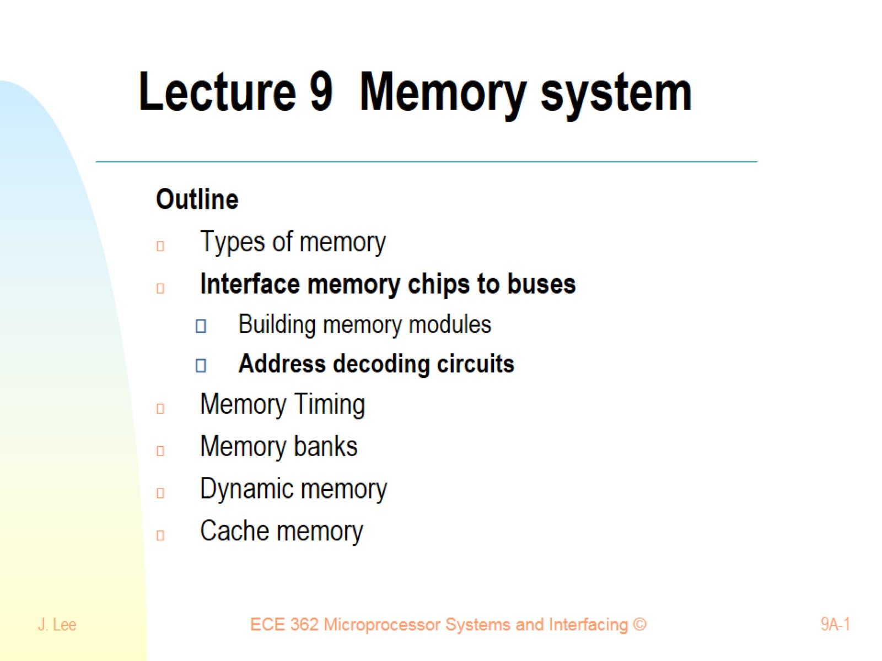
Lecture 9 Memory system

Slide 2
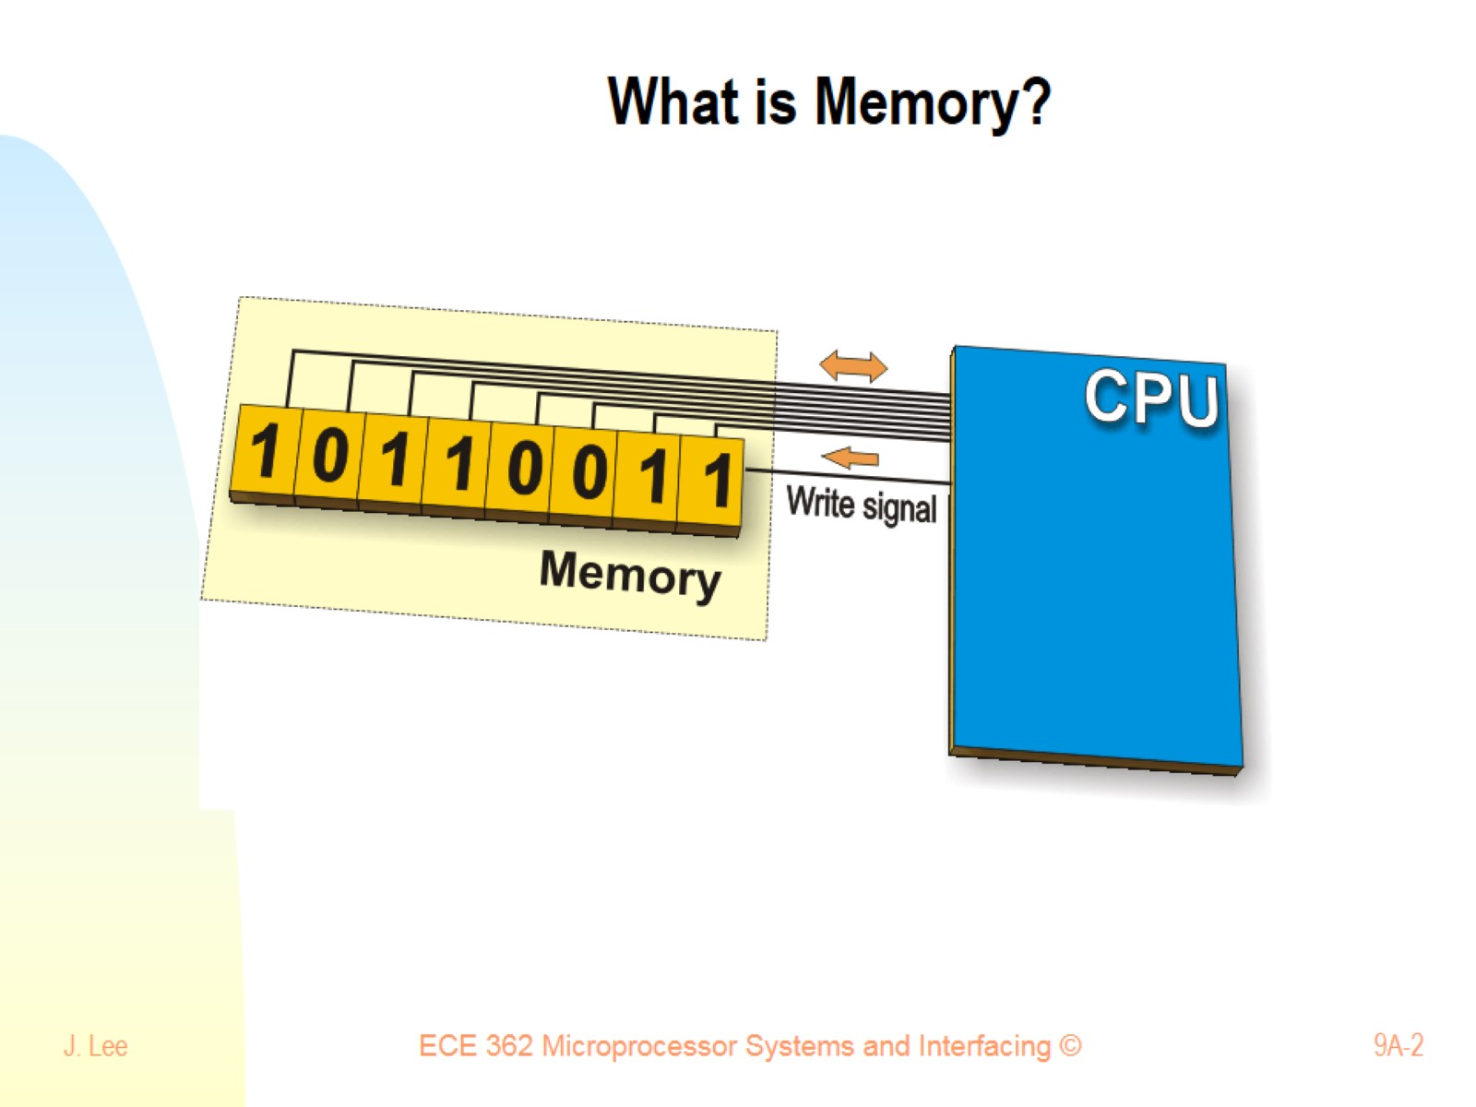
What is Memory?

Slide 3
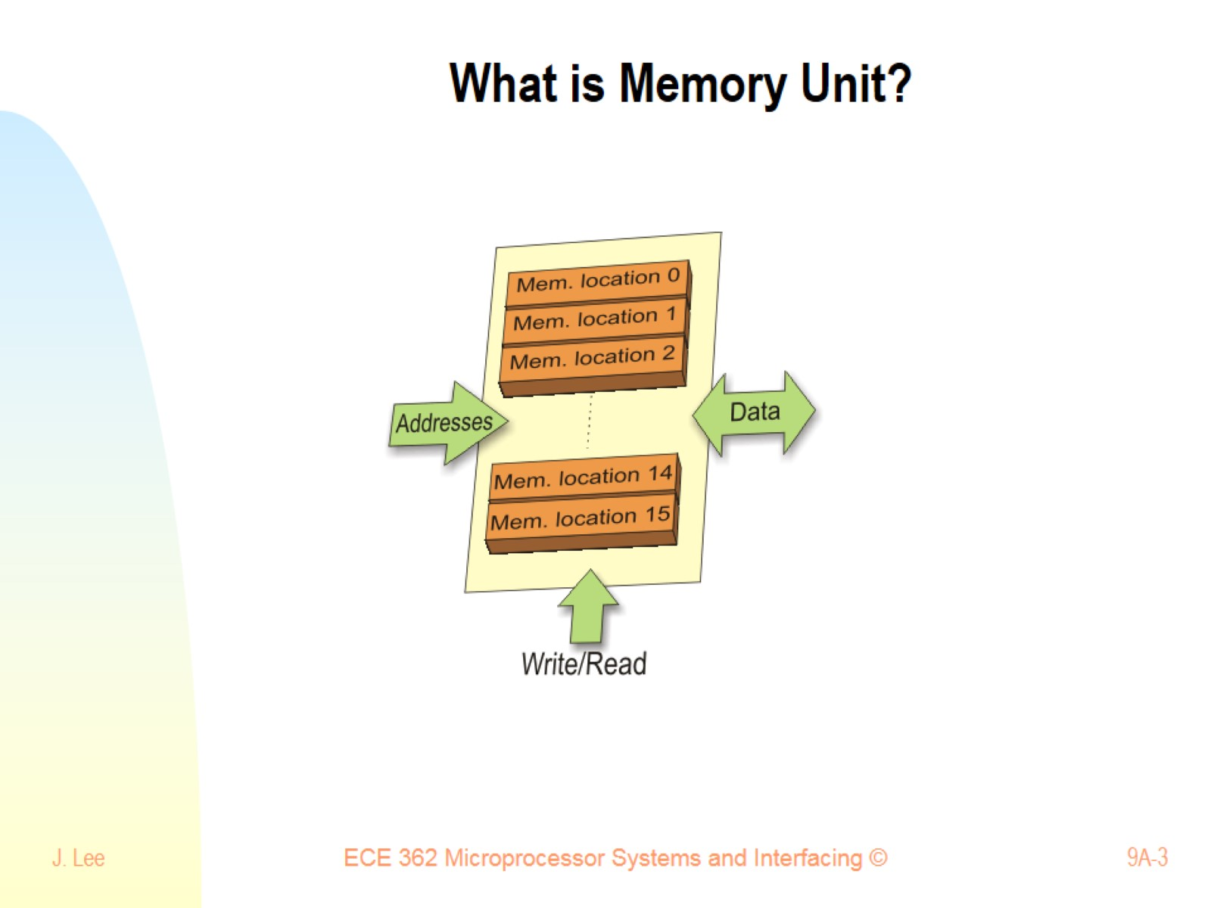
What is Memory Unit?

Slide 4
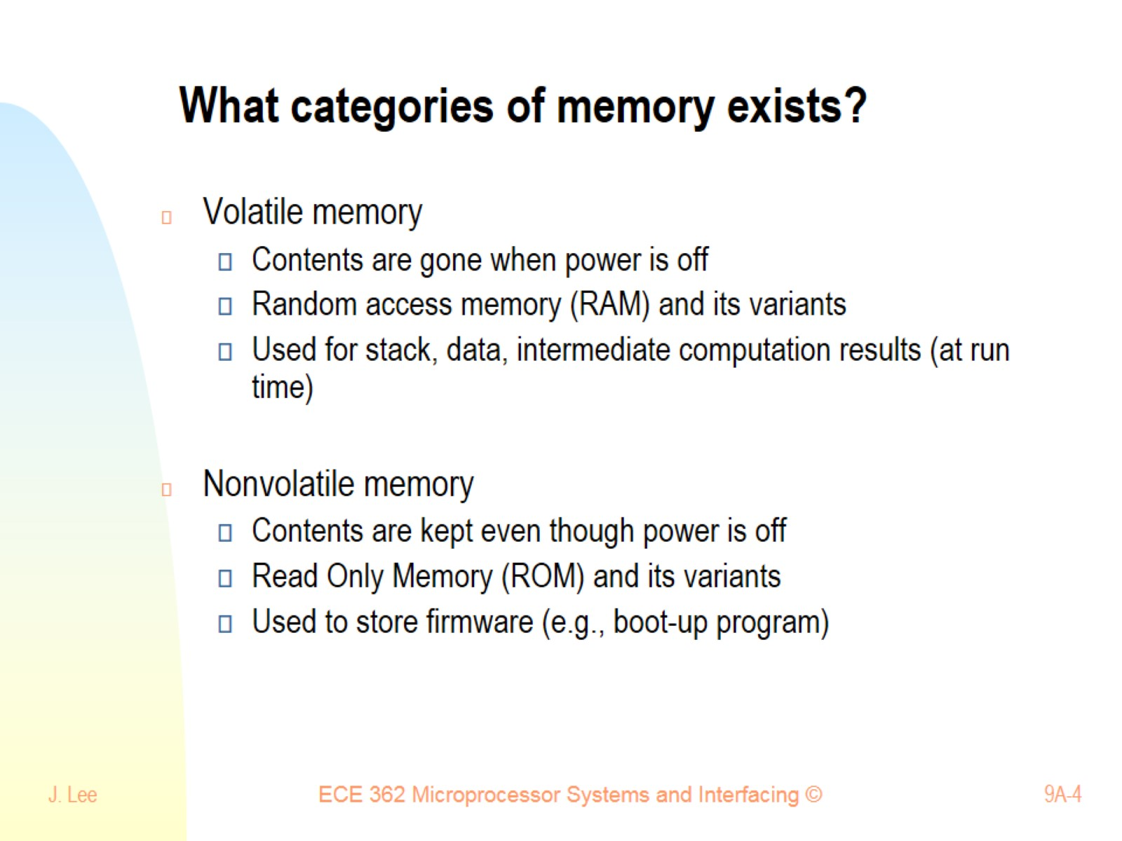
What categories of memory exists?

Slide 5
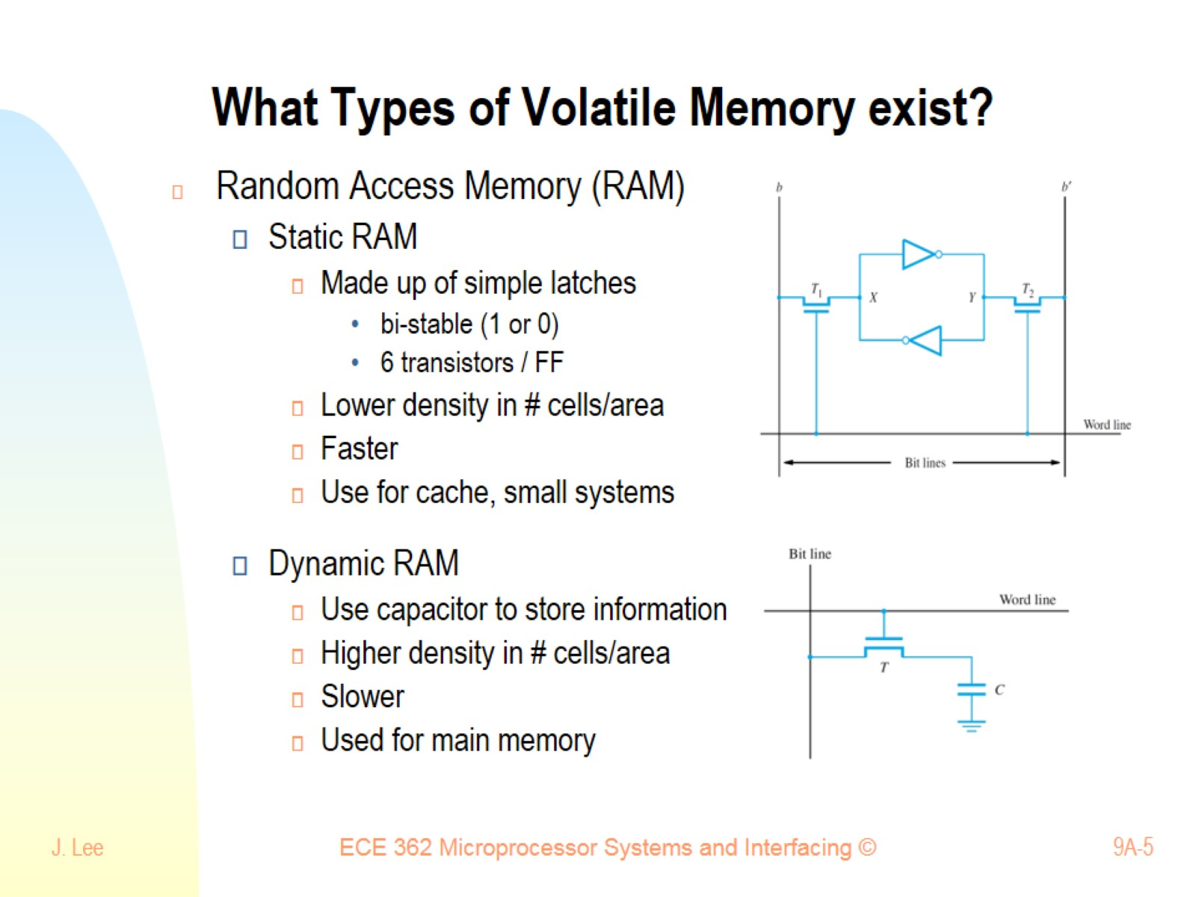
What Types of Volatile Memory exist?

Slide 6
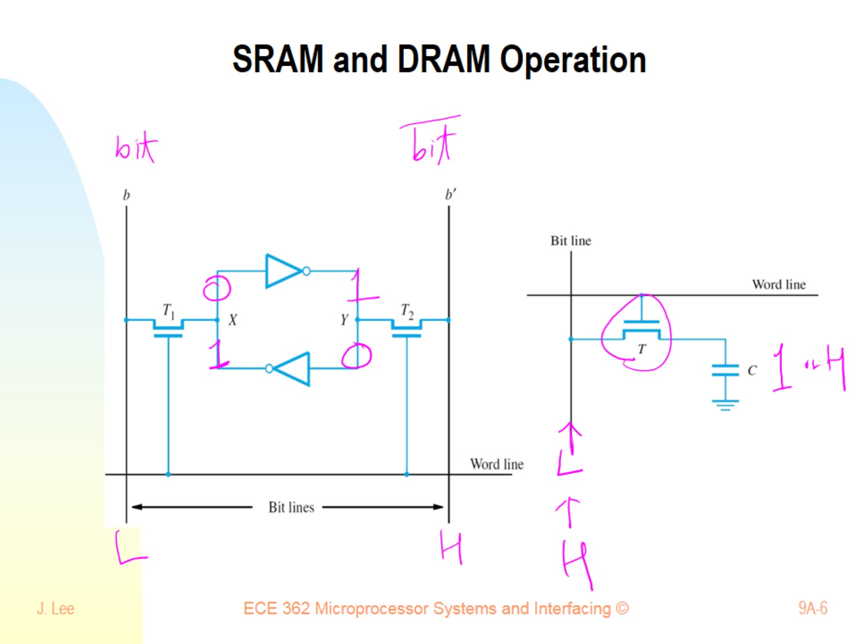
SRAM and DRAM Operation

Slide 7
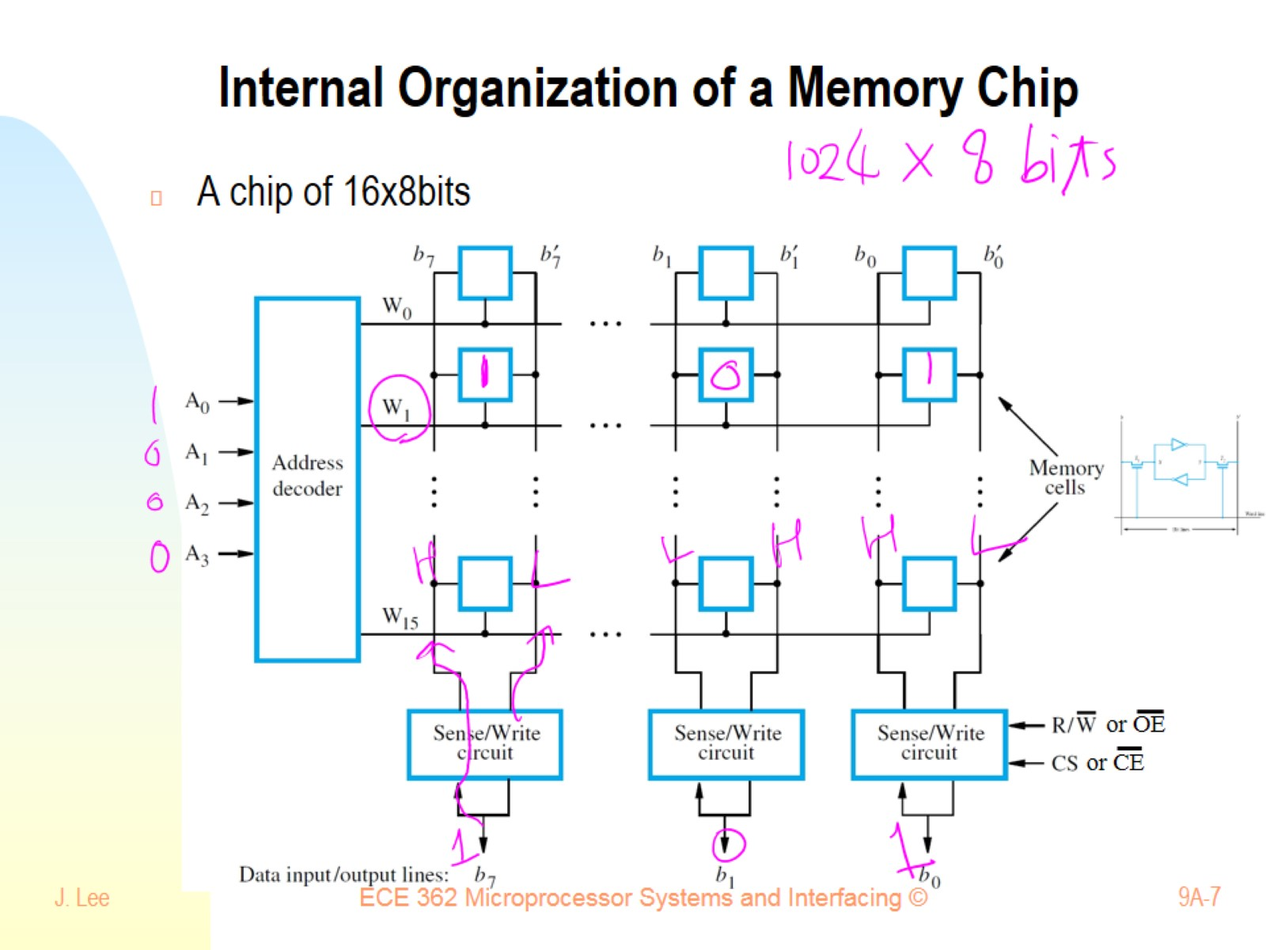
Internal Organization of a Memory Chip

Slide 8
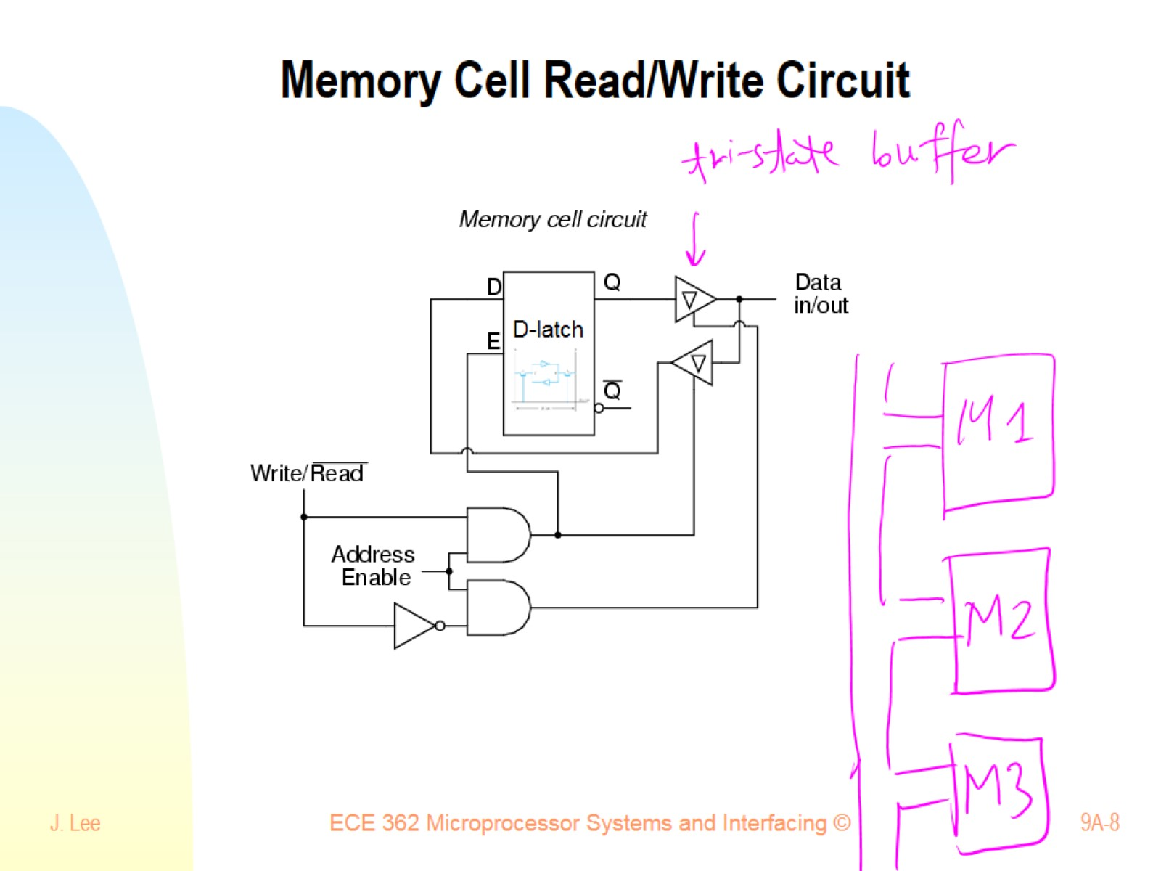
Memory Cell Read/Write Circuit

Slide 9
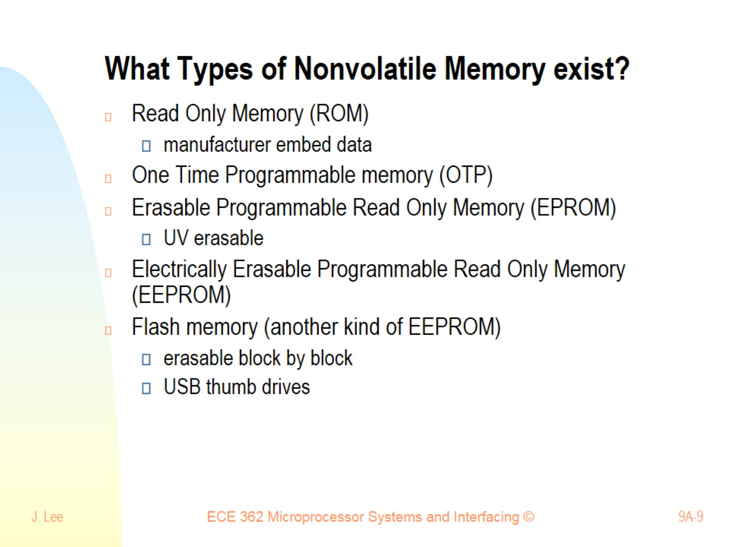
What Types of Nonvolatile Memory exist?

Slide 10
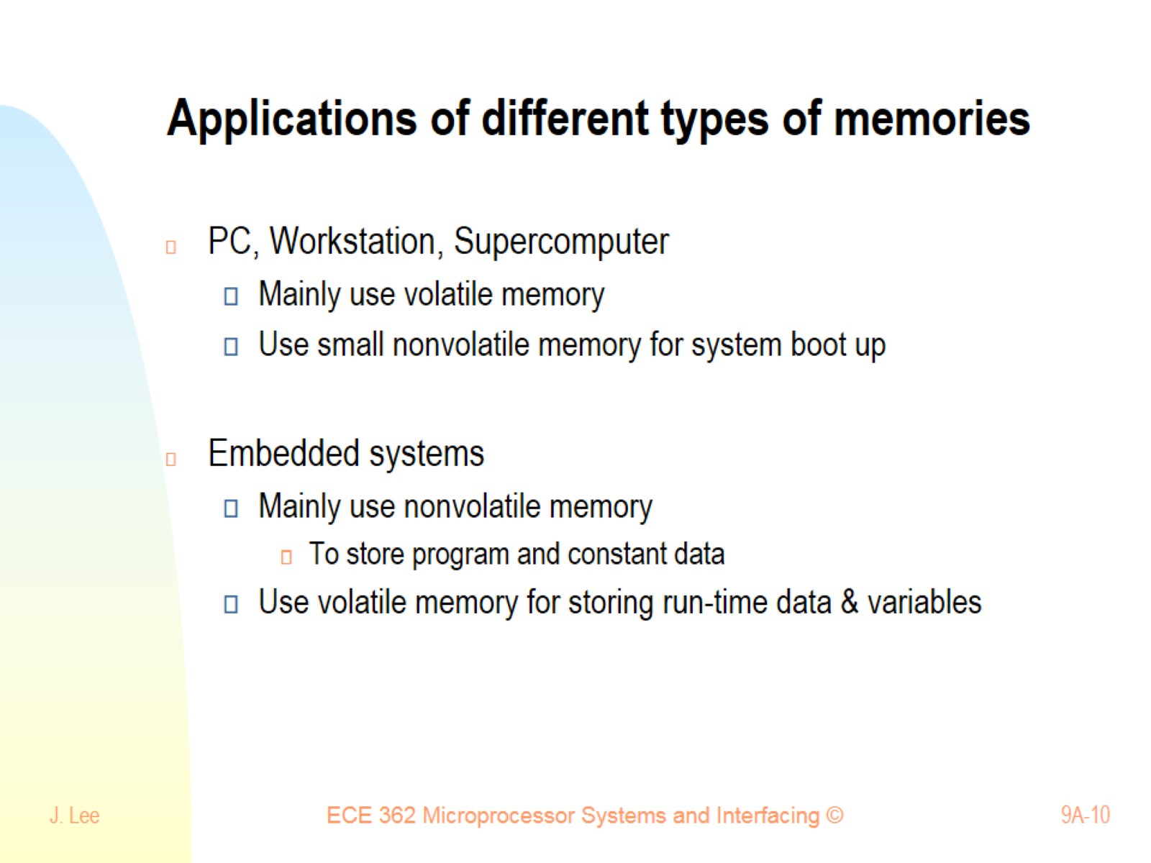
Applications of different types of memories

Slide 11
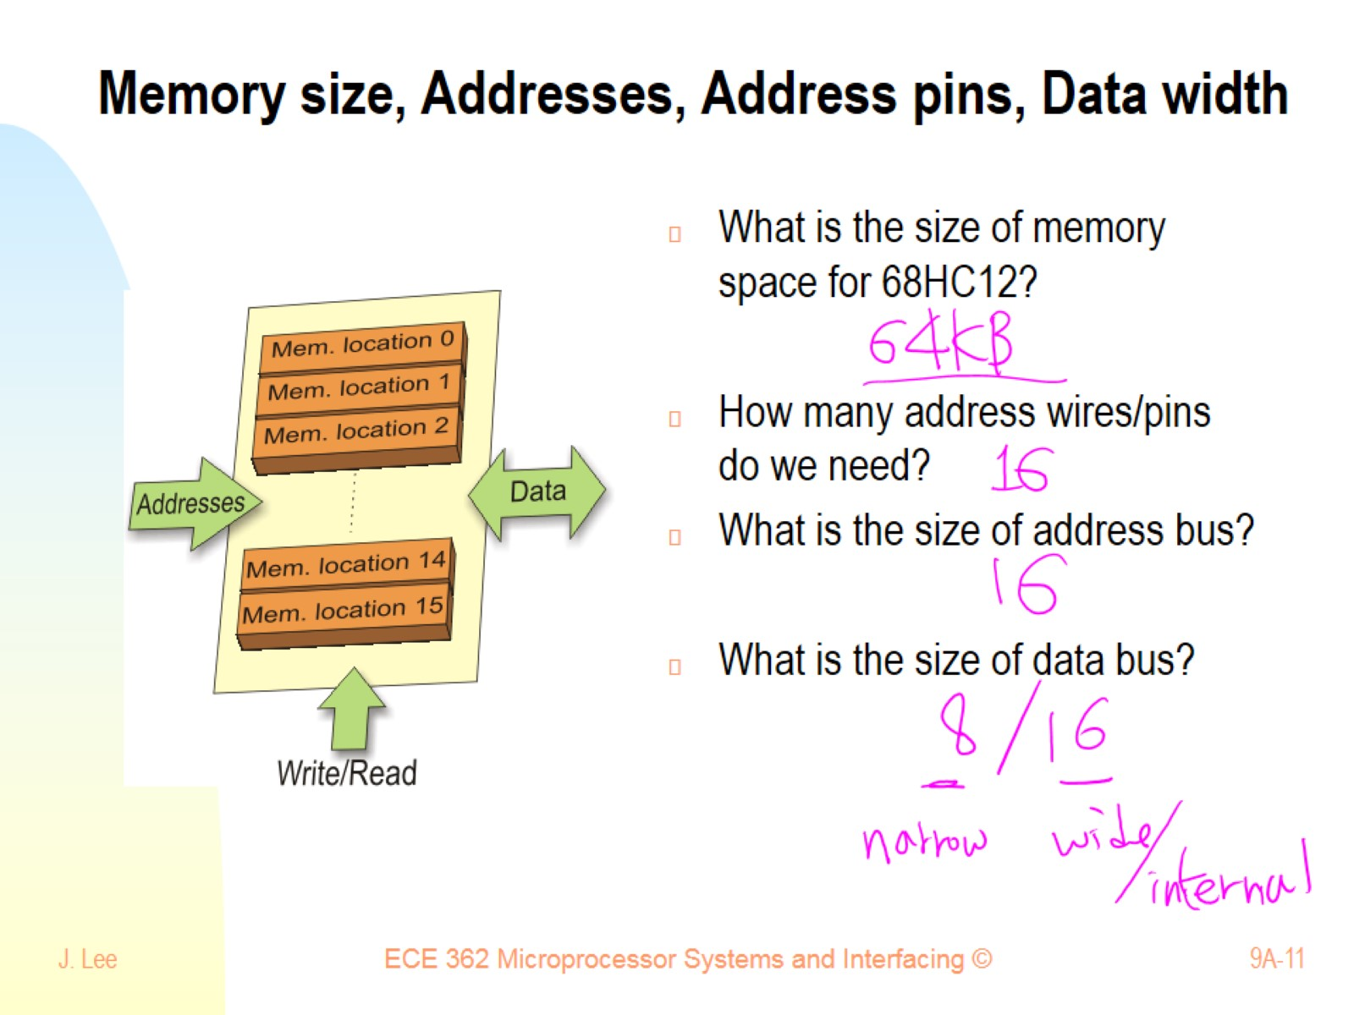
Memory size, Addresses, Address pins, Data width

Slide 12
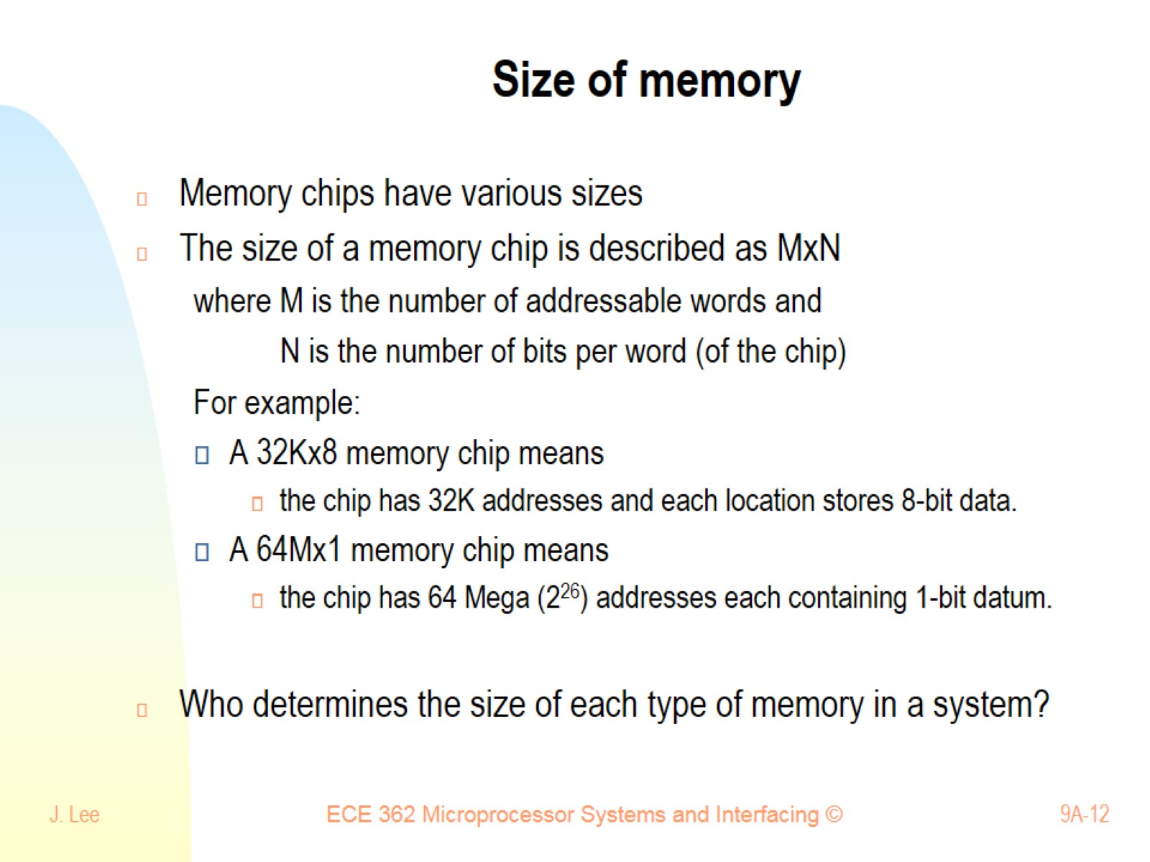
Size of memory

Slide 13
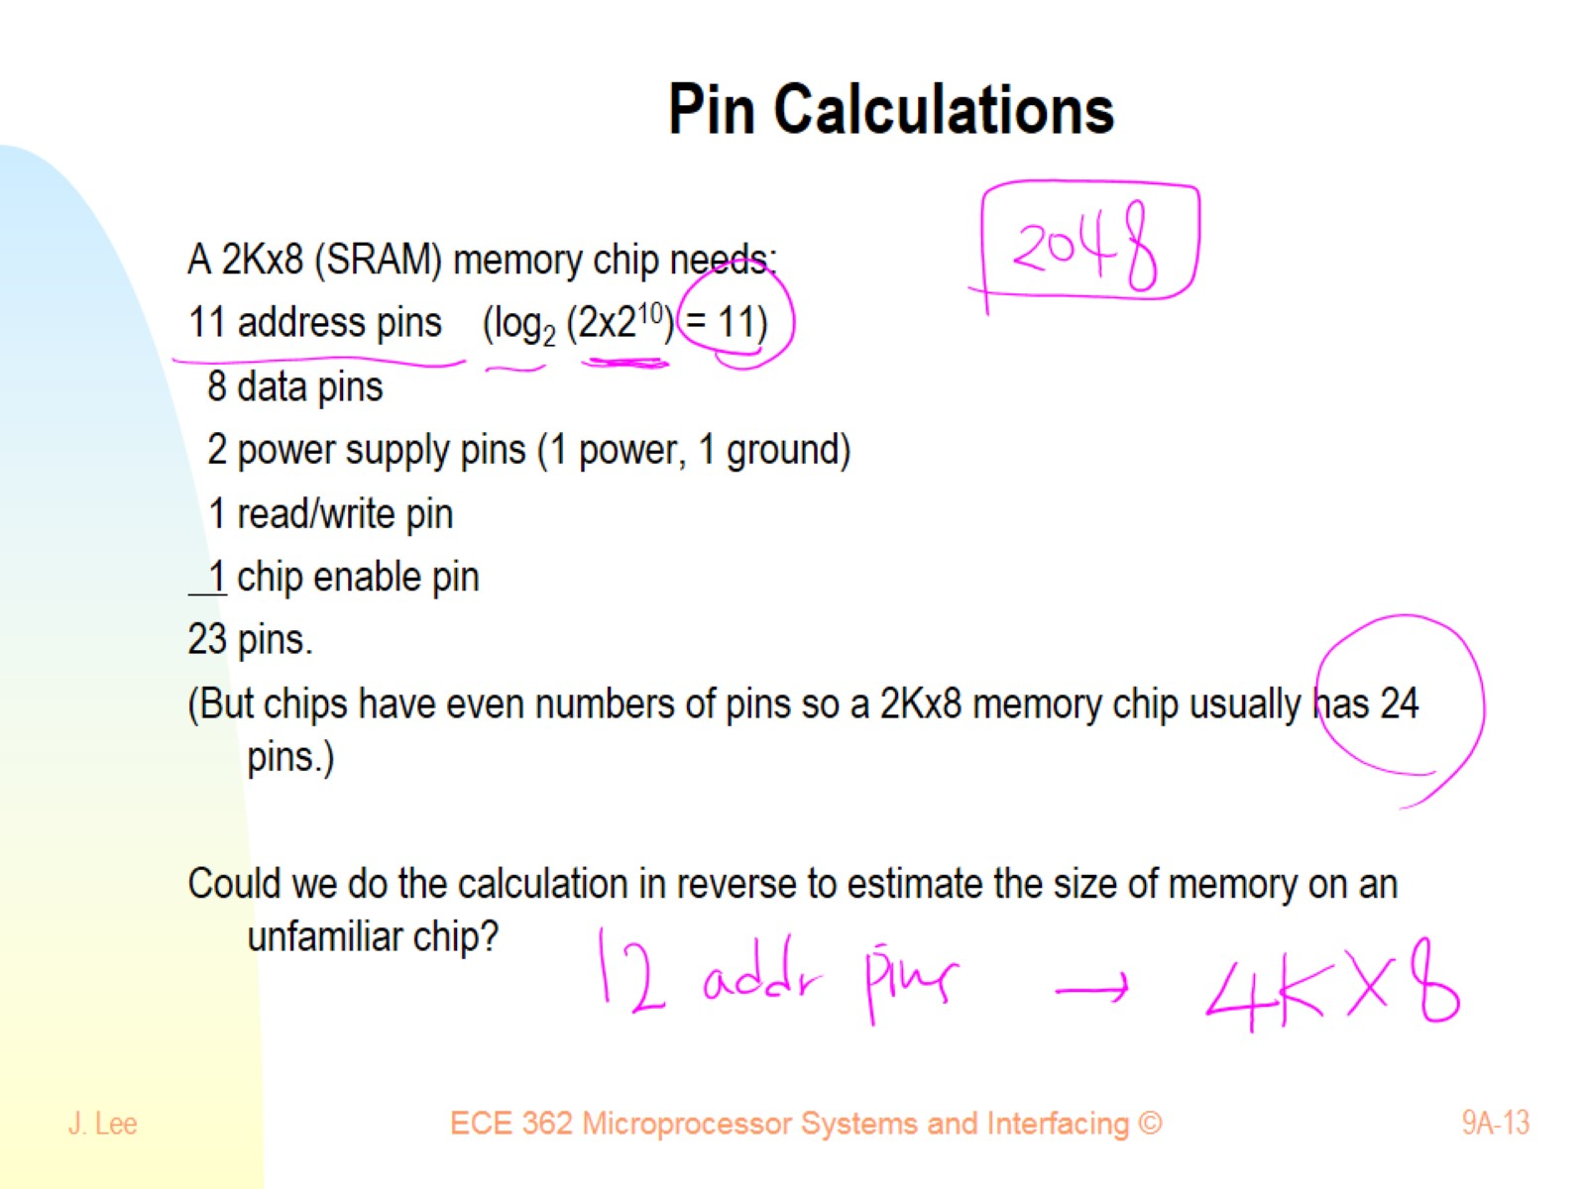
Pin Calculations

Slide 14
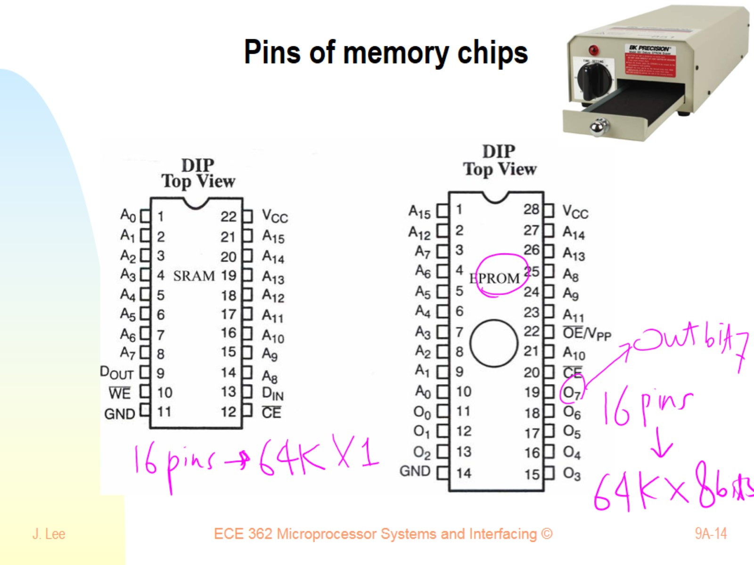
Pins of memory chips

Slide 15
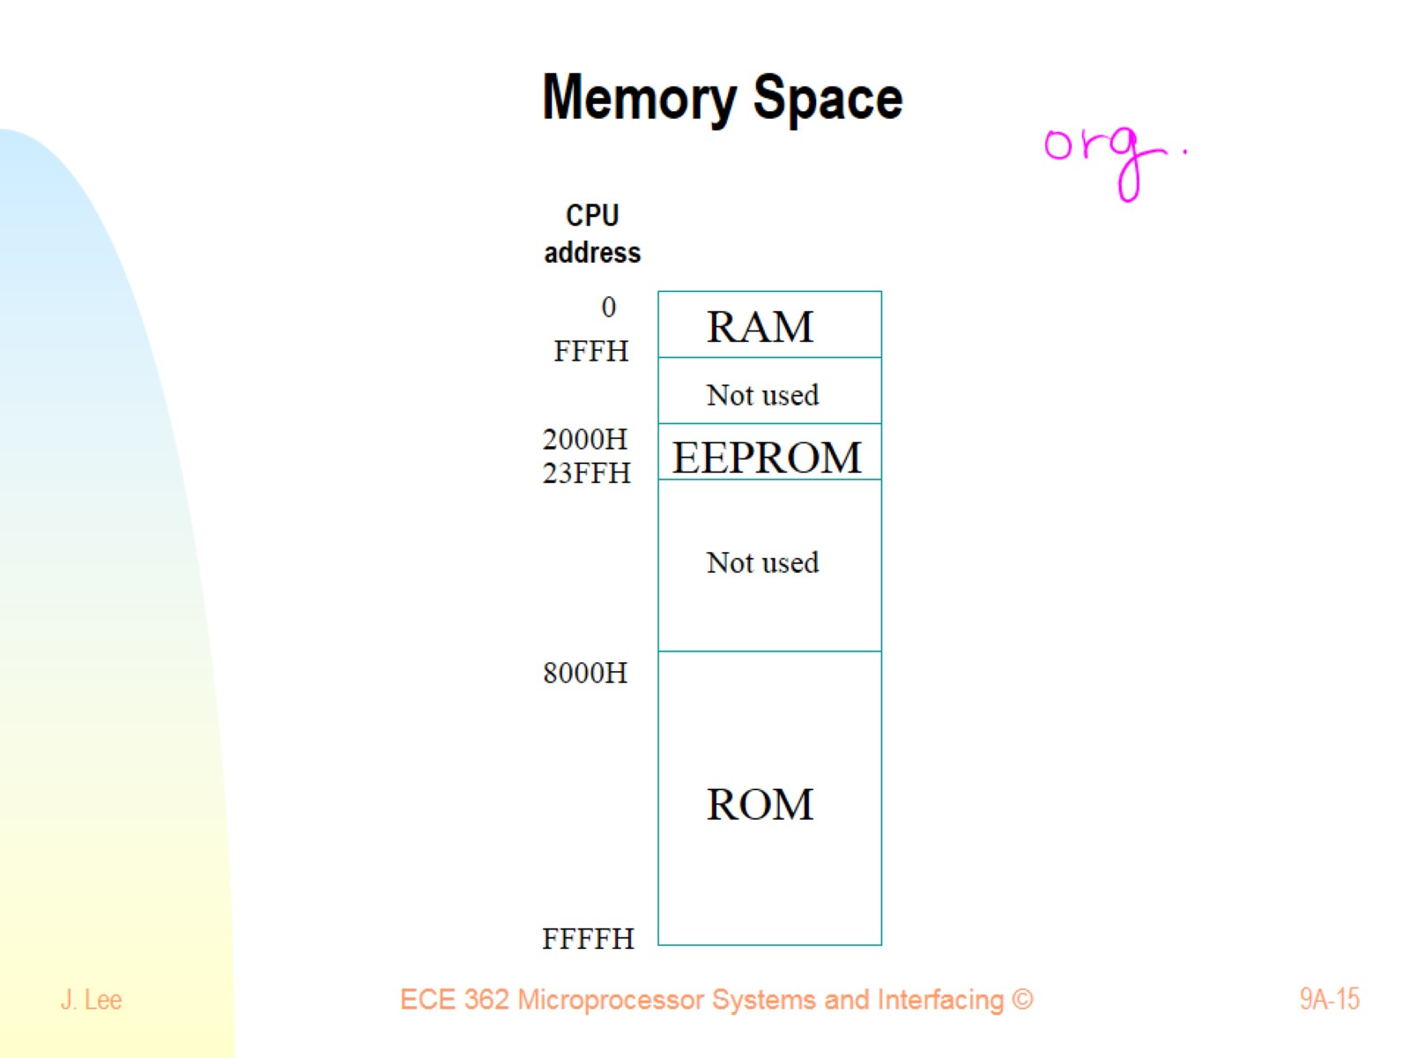
Memory Space

Slide 16
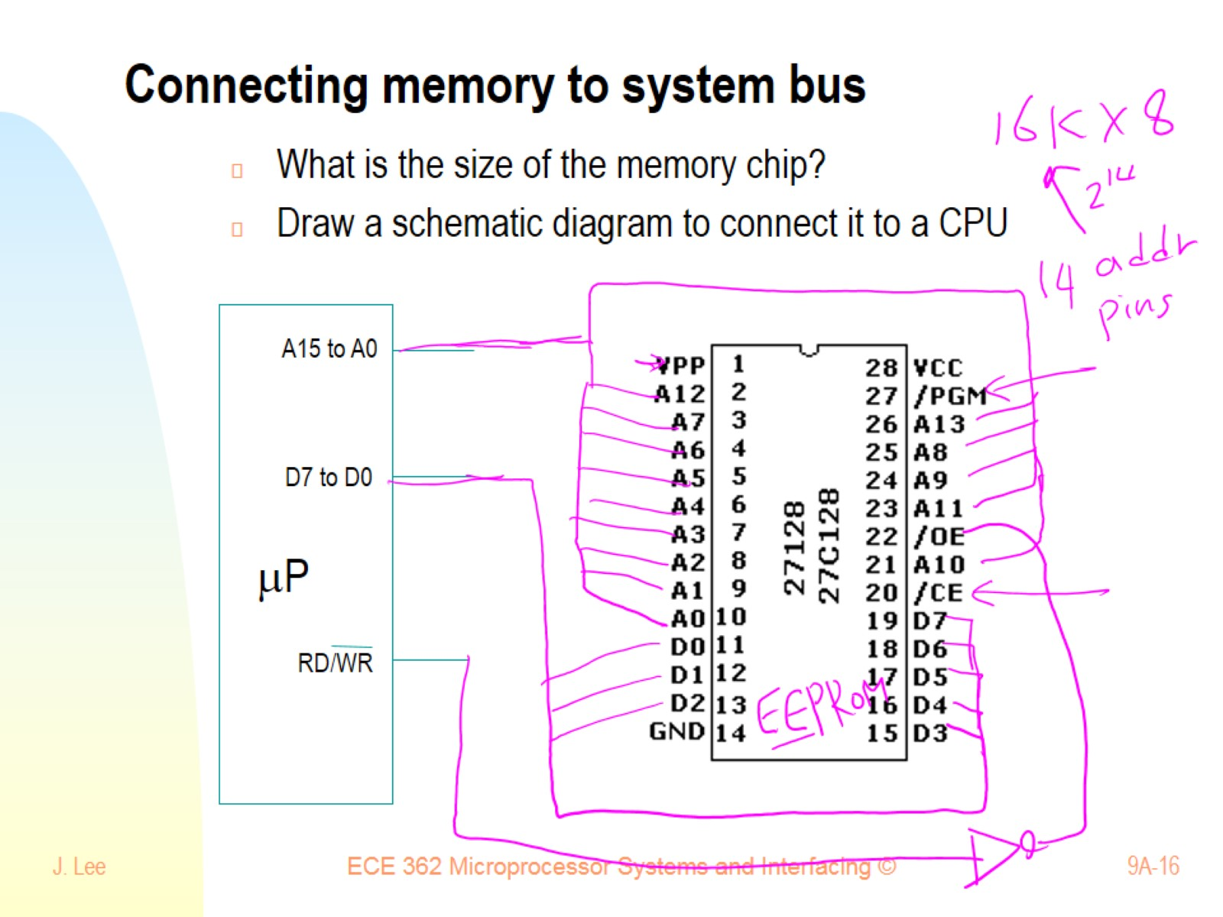
Connecting memory to system bus

Slide 17
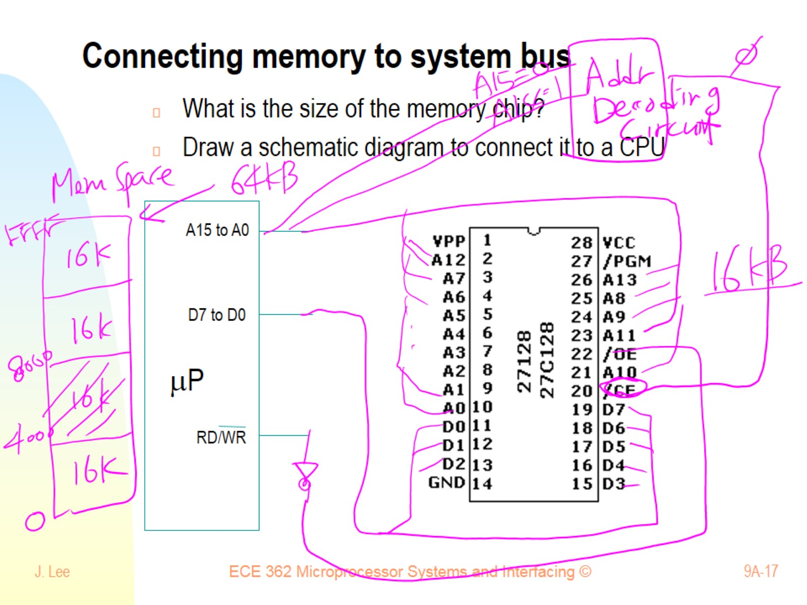
Connecting memory to system bus

Slide 18
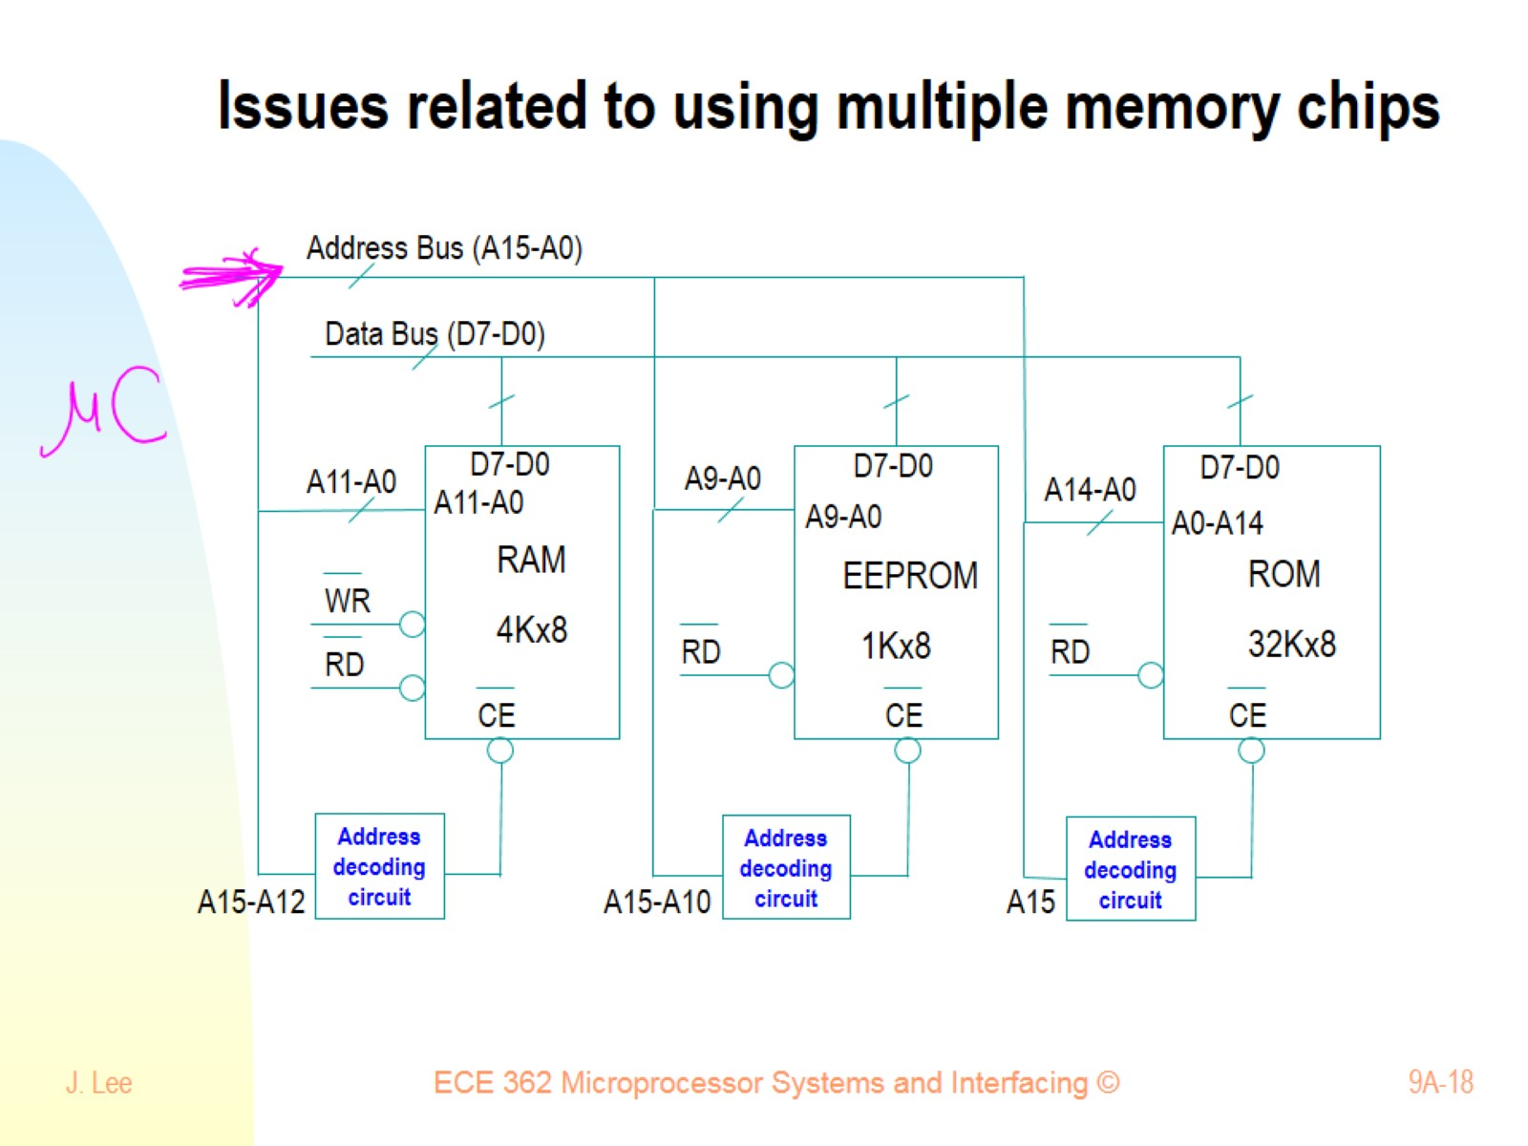
Issues related to using multiple memory chips

Slide 19
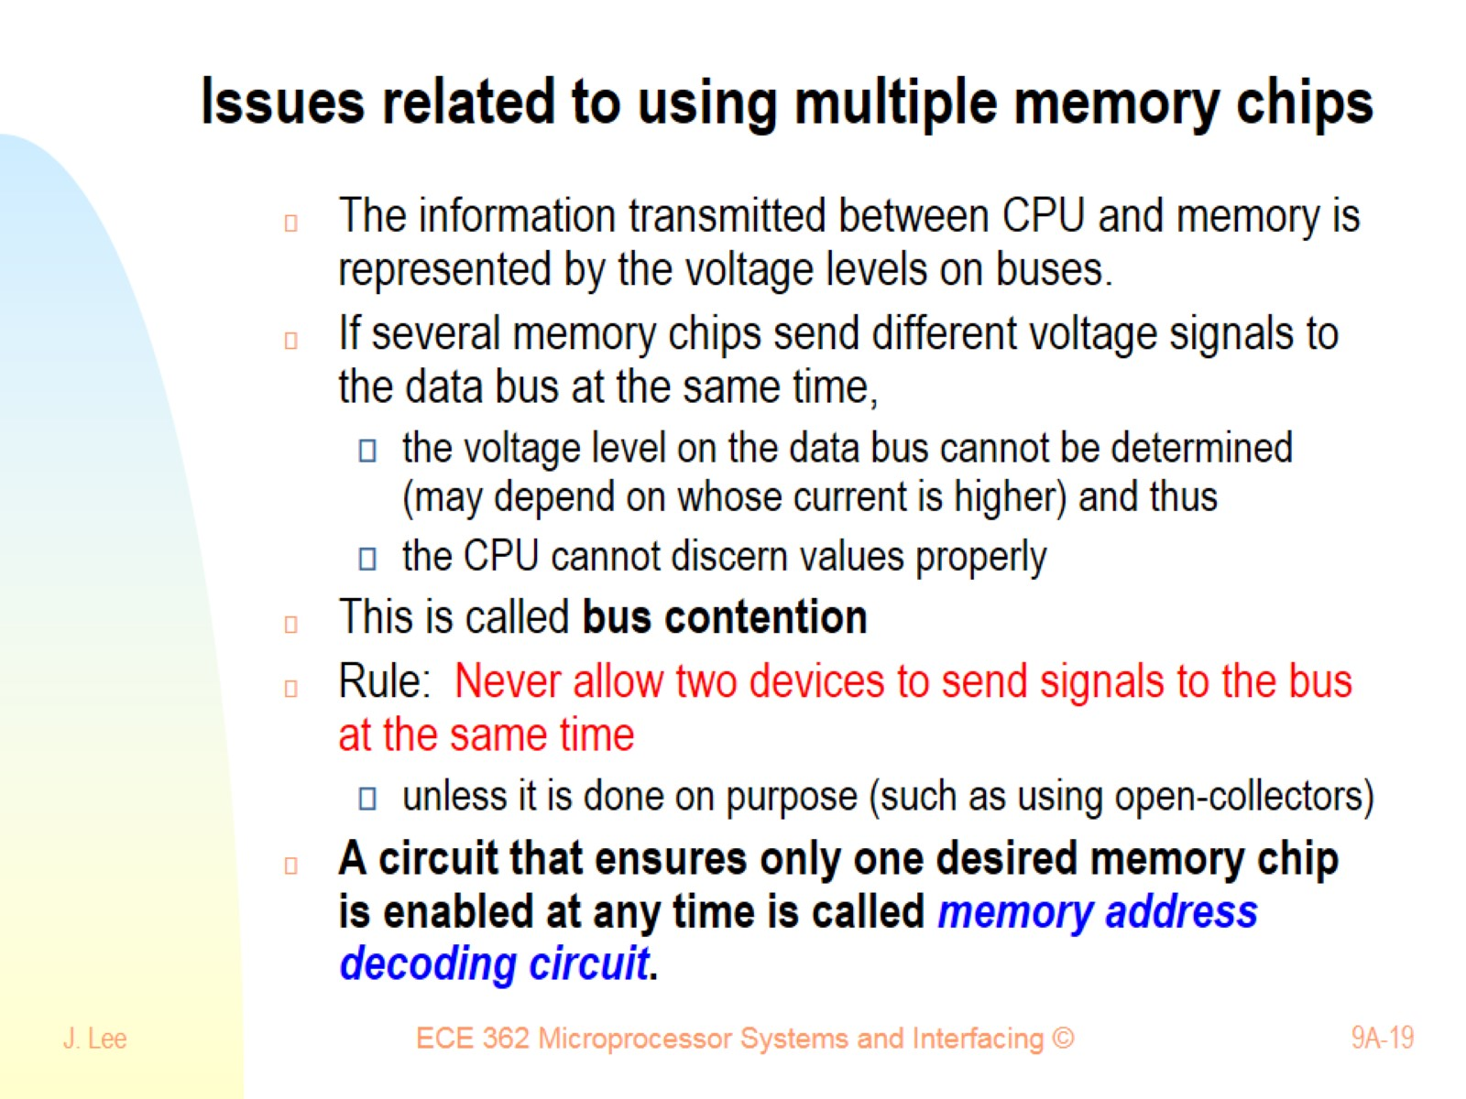
Issues related to using multiple memory chips

Slide 20
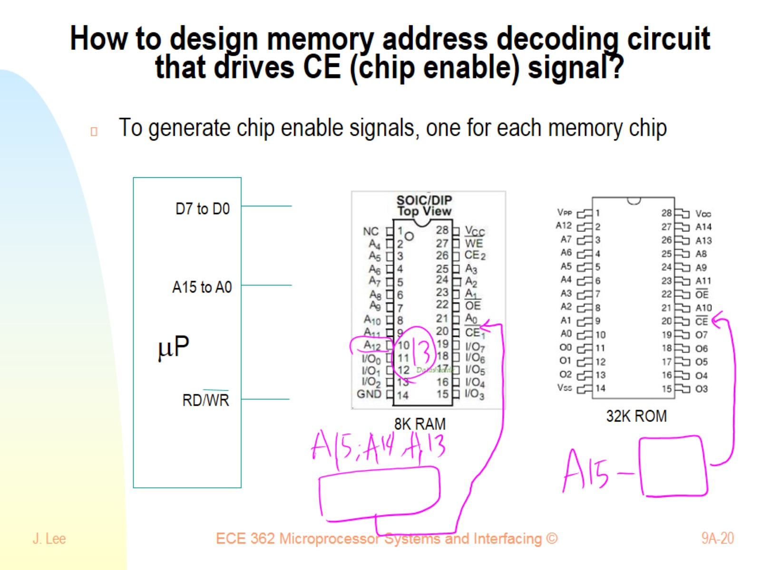
How to design memory address decoding circuit that drives CE (chip enable) signal?

Slide 21
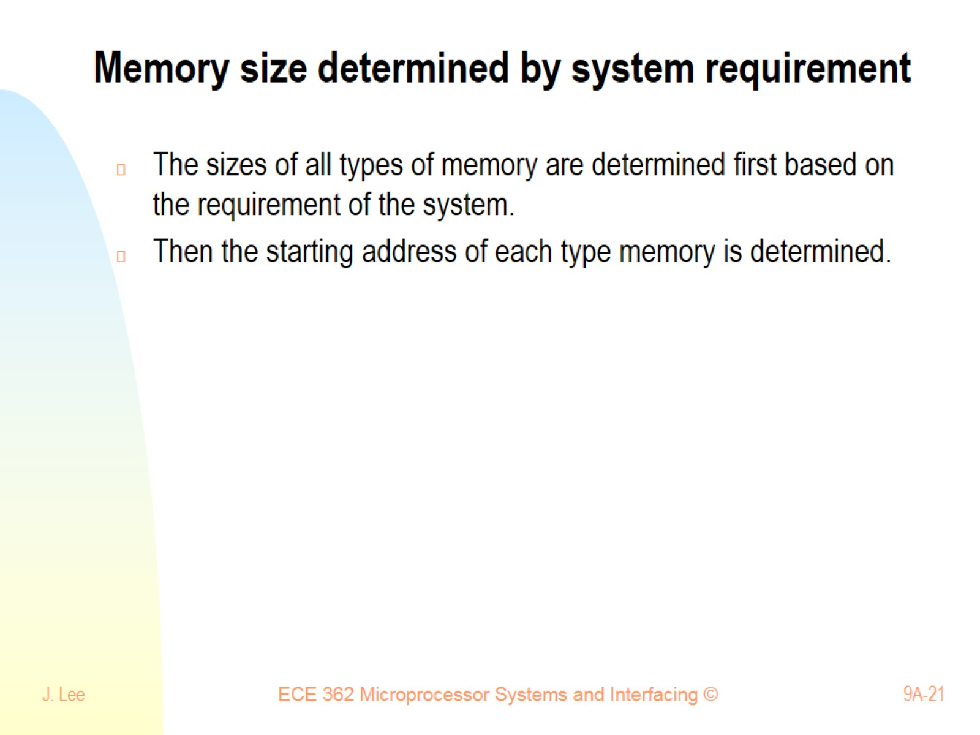
Memory size determined by system requirement

Slide 22
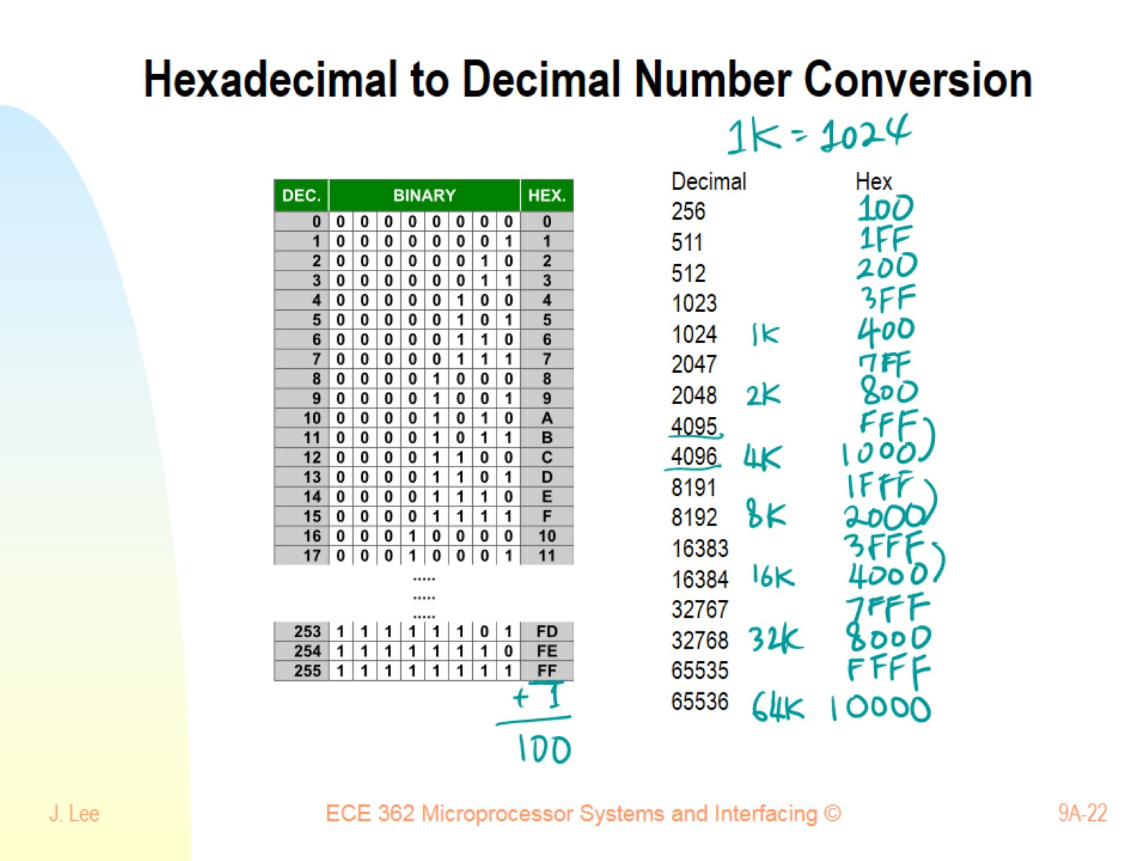
Hexadecimal to Decimal Number Conversion

Slide 23
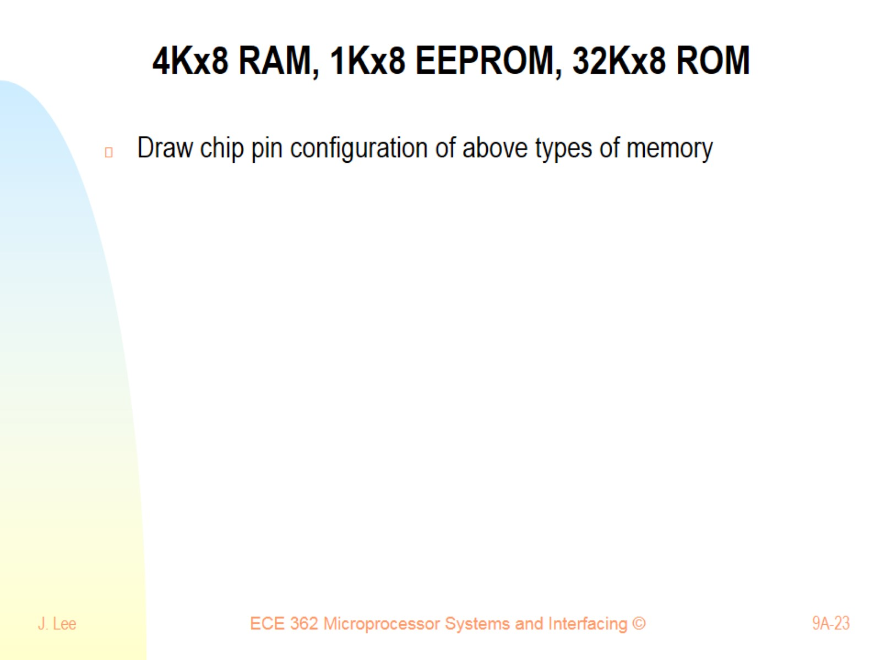
4Kx8 RAM, 1Kx8 EEPROM, 32Kx8 ROM

Slide 24
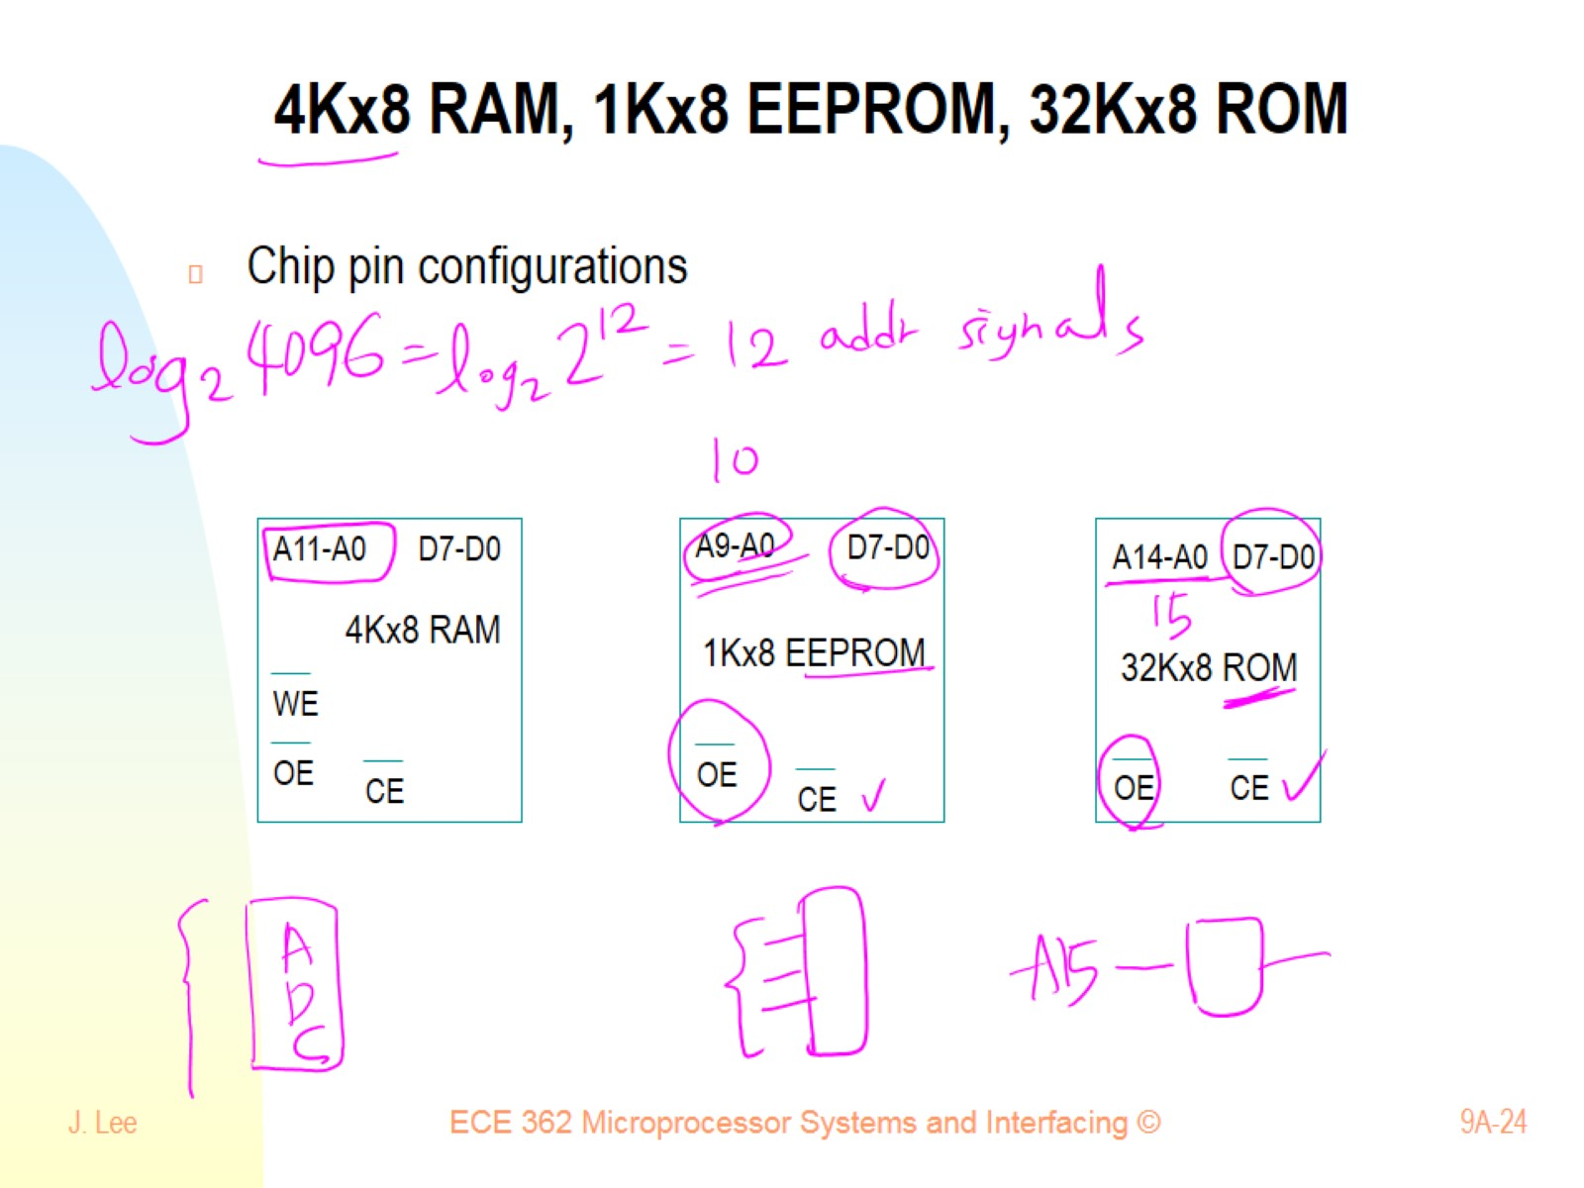
4Kx8 RAM, 1Kx8 EEPROM, 32Kx8 ROM

Slide 25
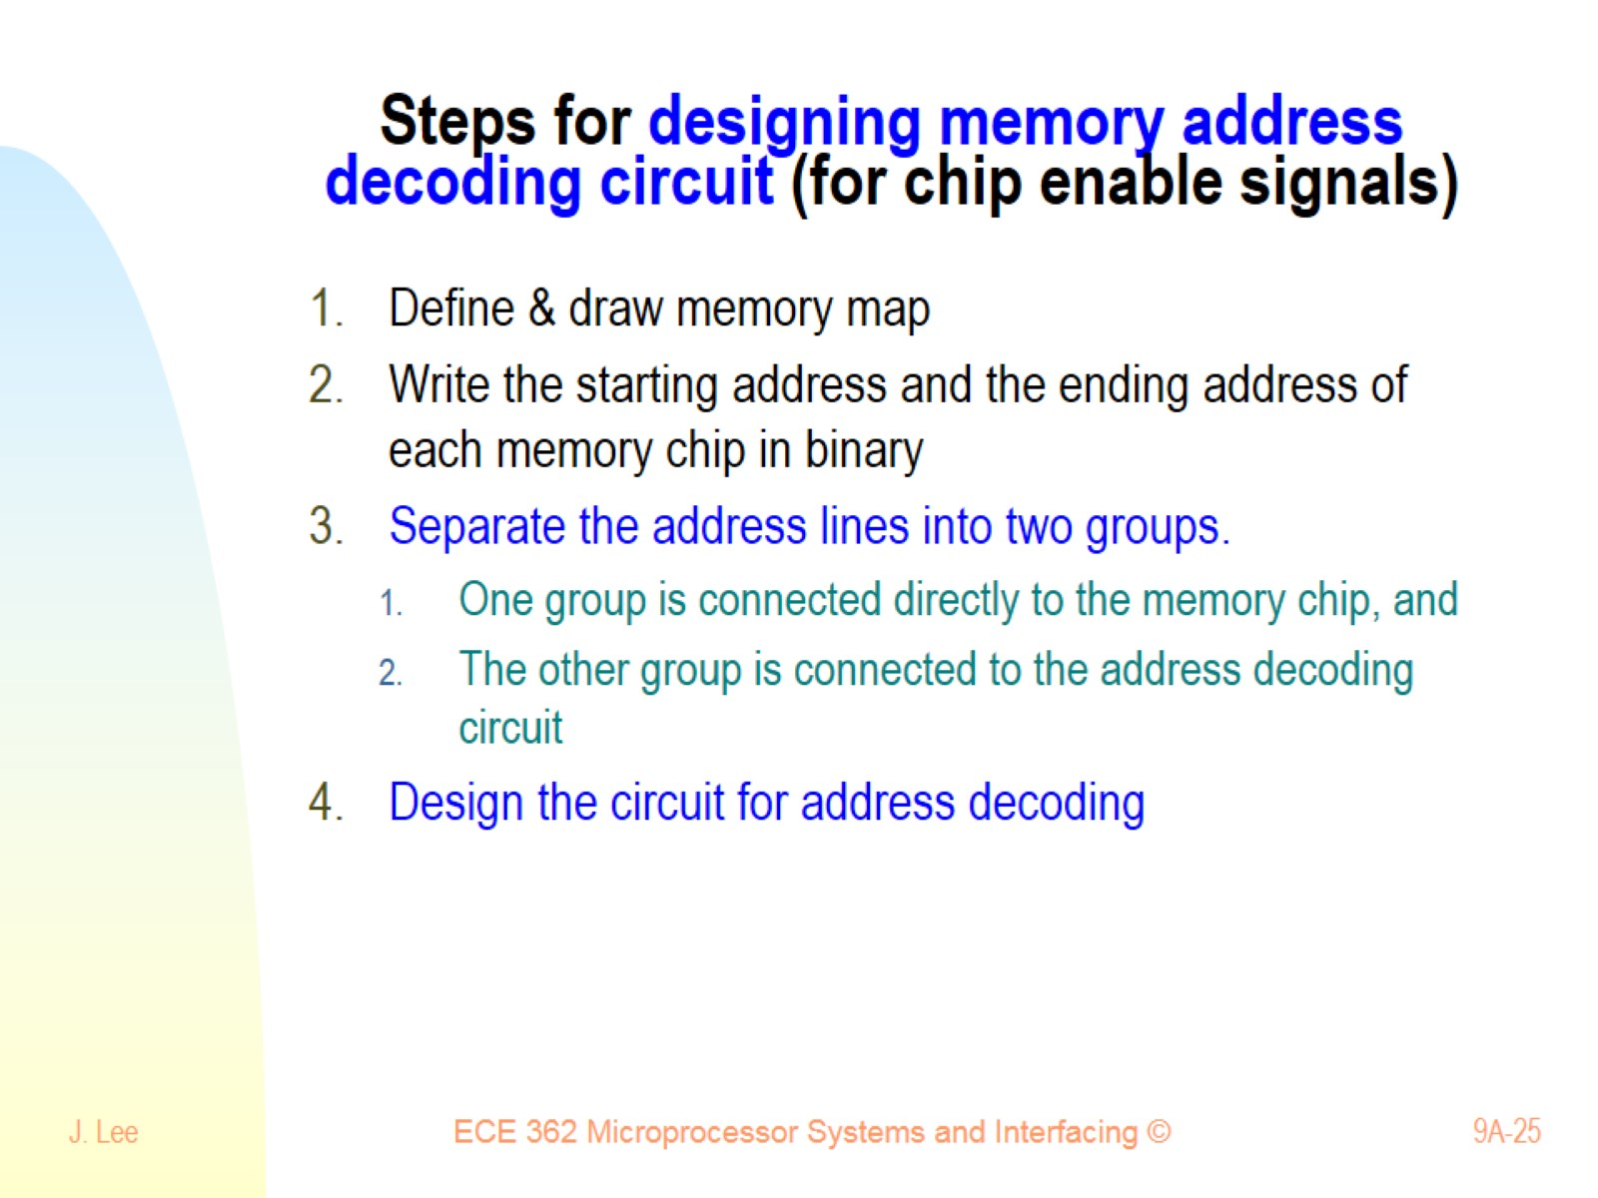
Steps for designing memory address decoding circuit (for chip enable signals)

Slide 26
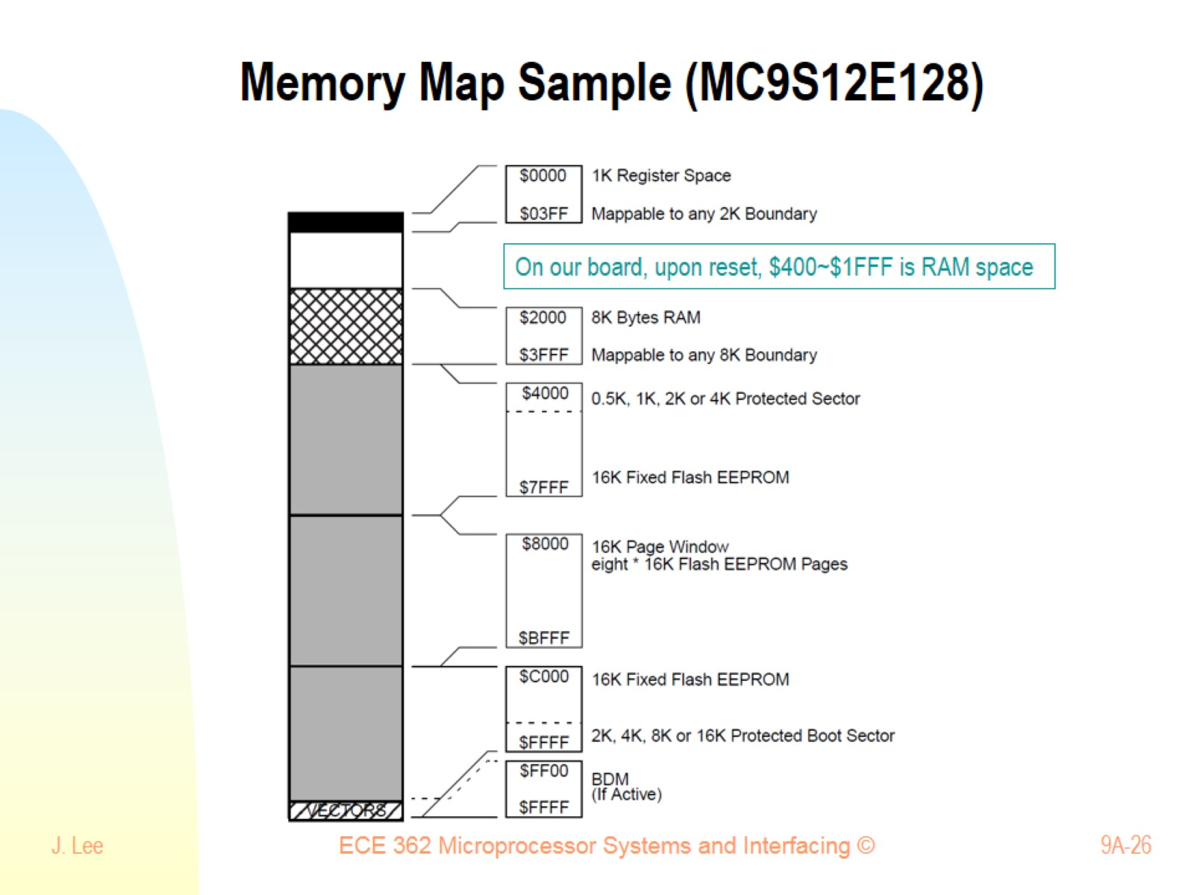
Memory Map Sample (MC9S12E128)

Slide 27
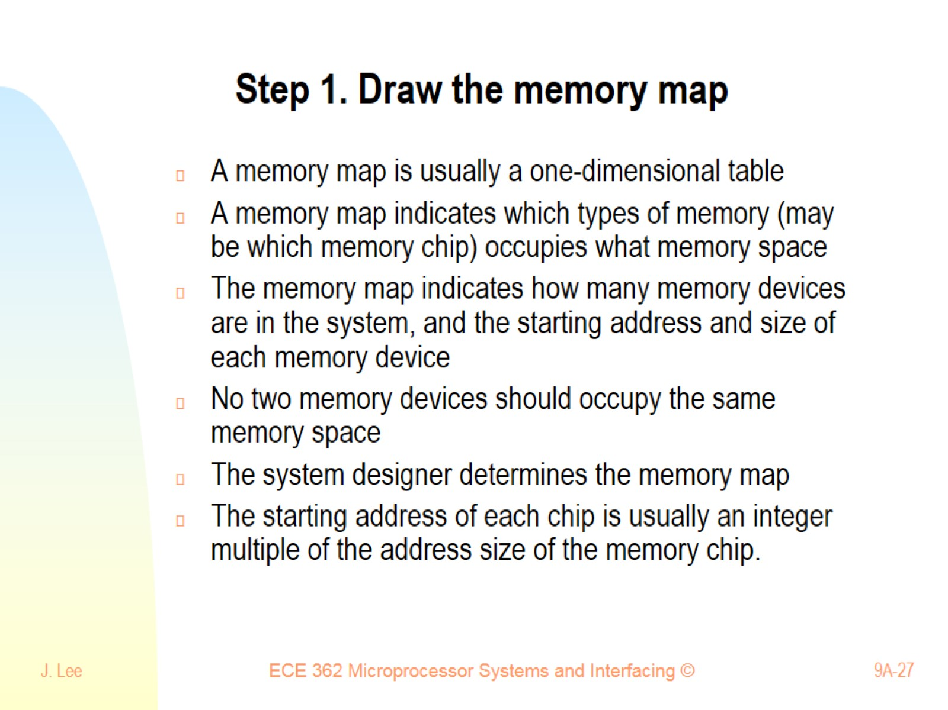
Step 1. Draw the memory map

Slide 28
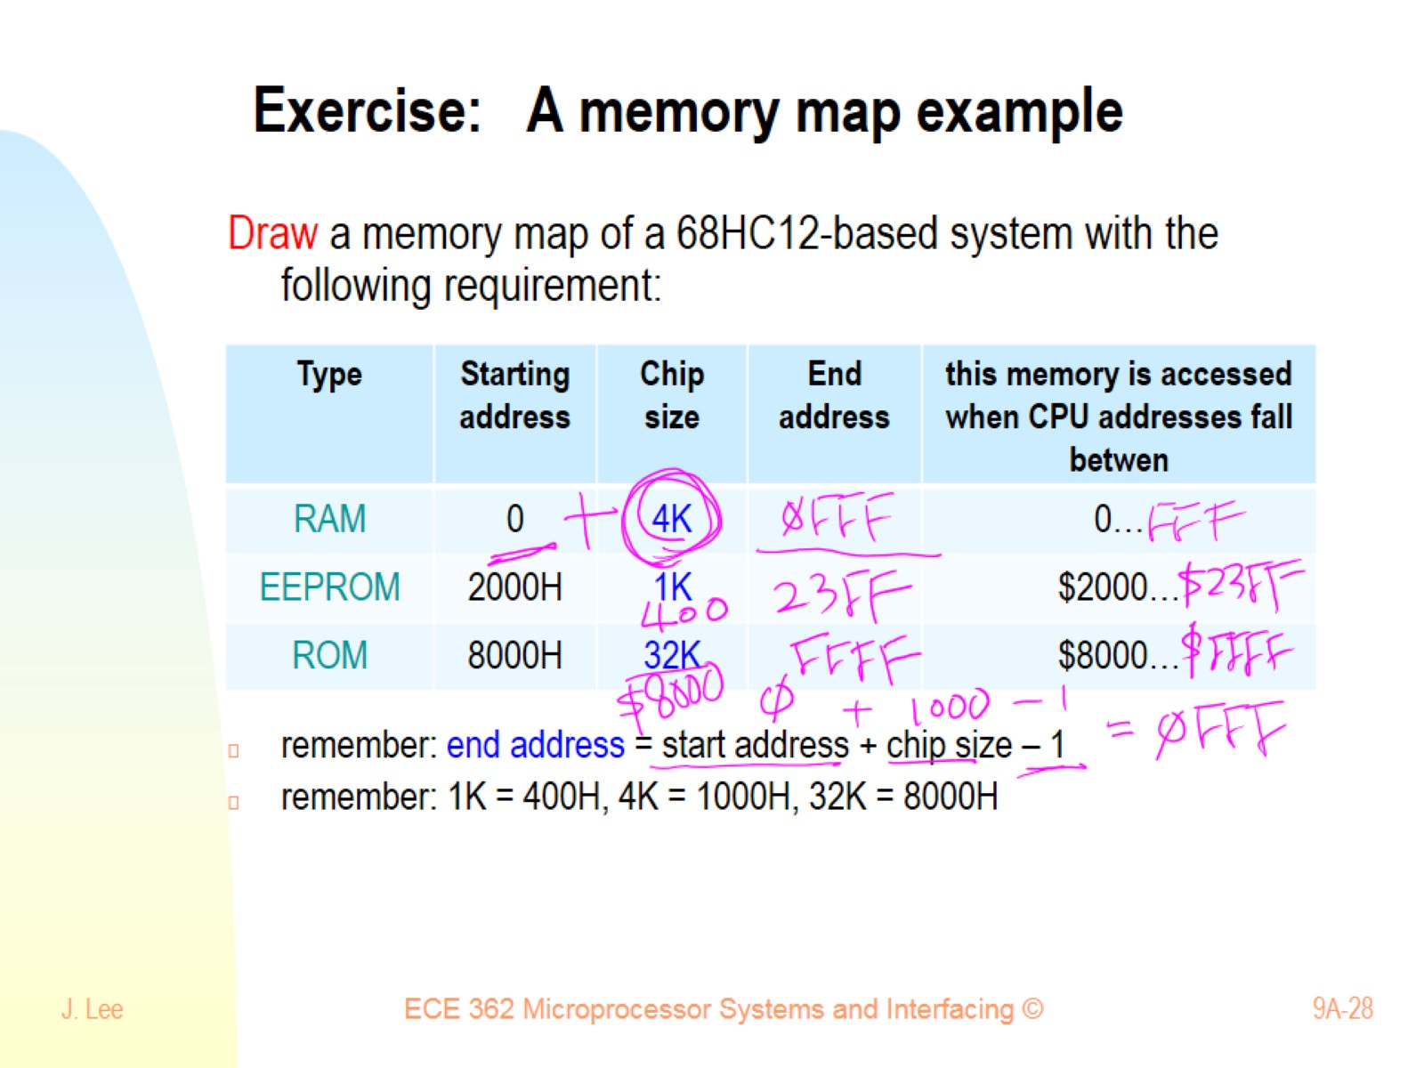
Exercise: A memory map example

Slide 29
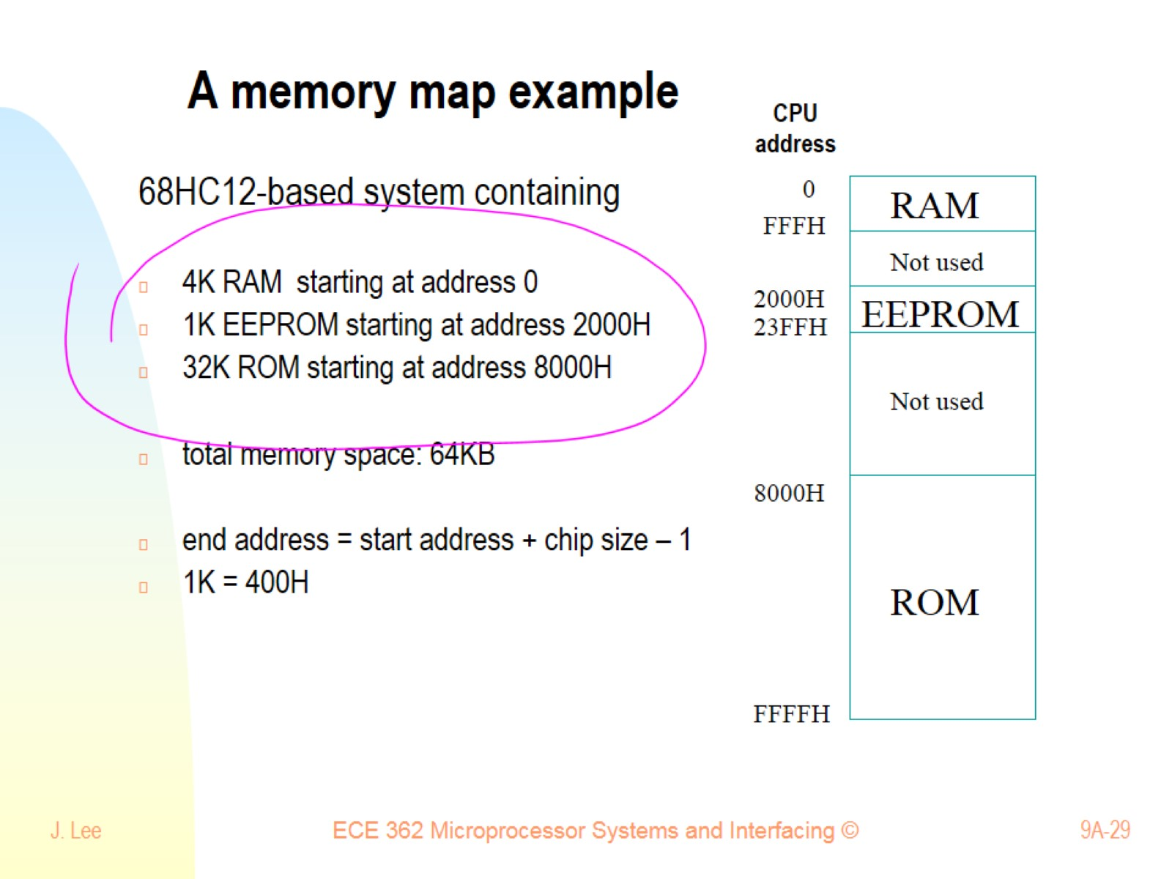
A memory map example

Slide 30
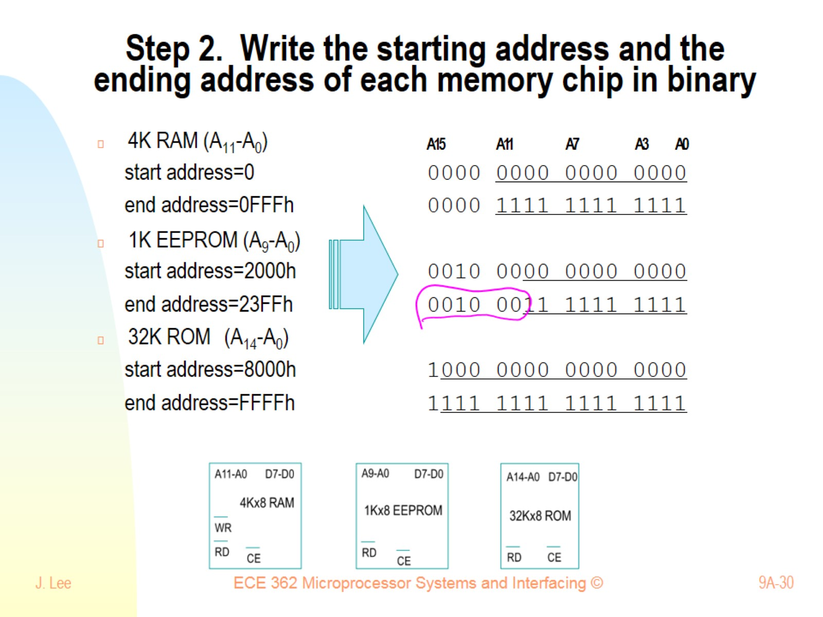
Step 2. Write the starting address and the ending address of each memory chip in binary

Slide 31
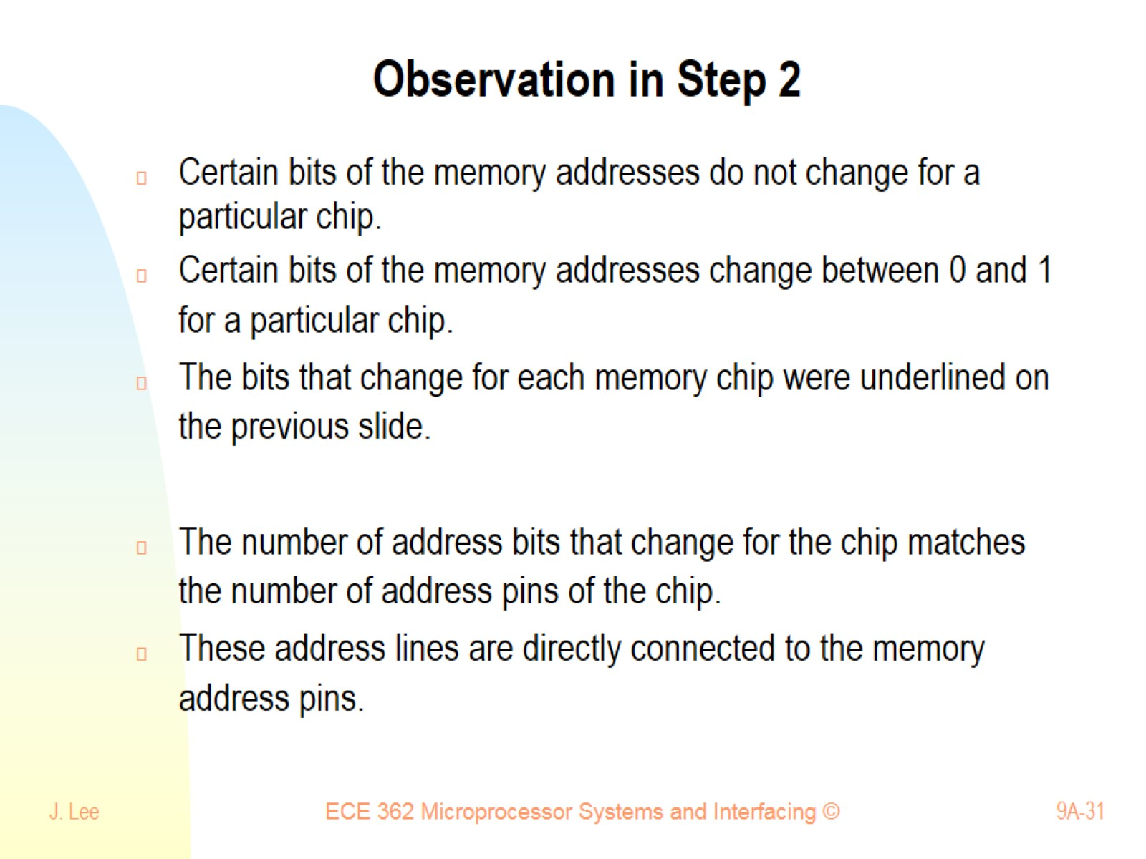
Observation in Step 2

Slide 32
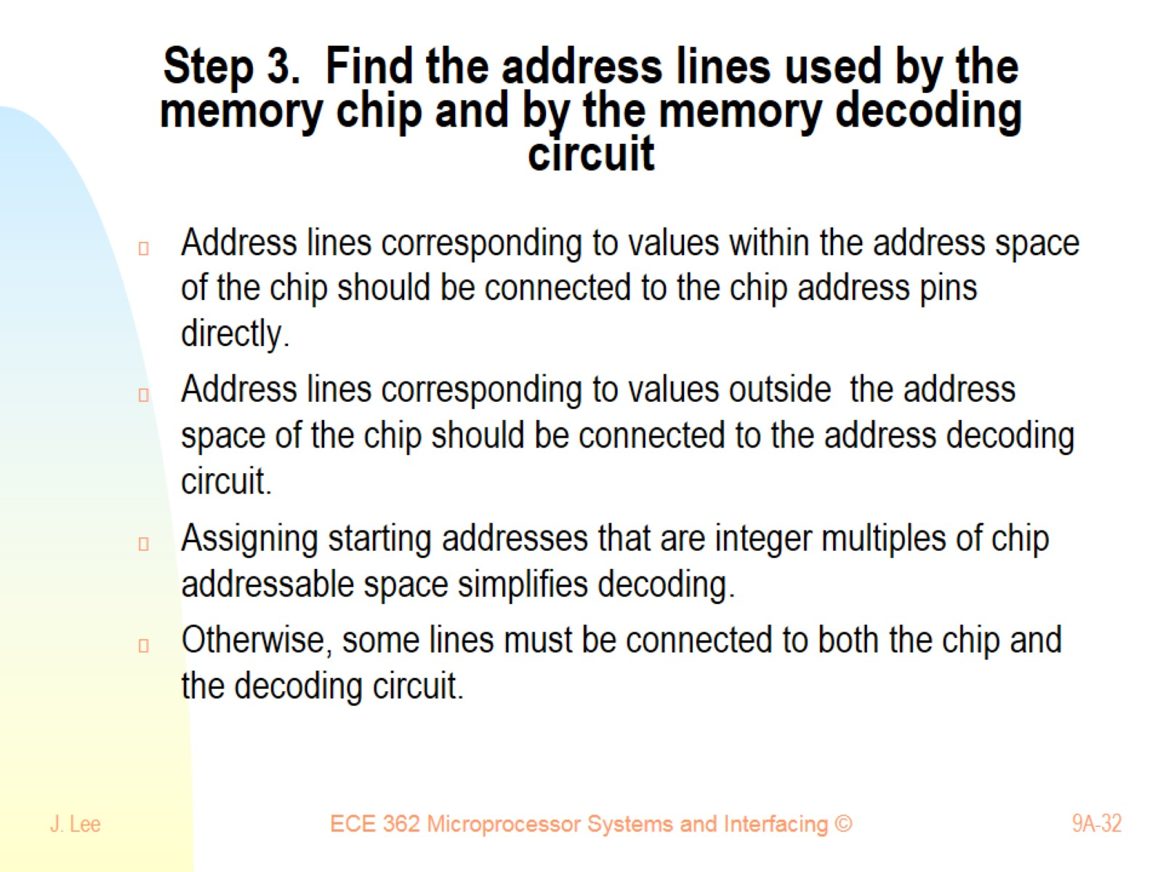
Step 3. Find the address lines used by the memory chip and by the memory decoding circuit

Slide 33
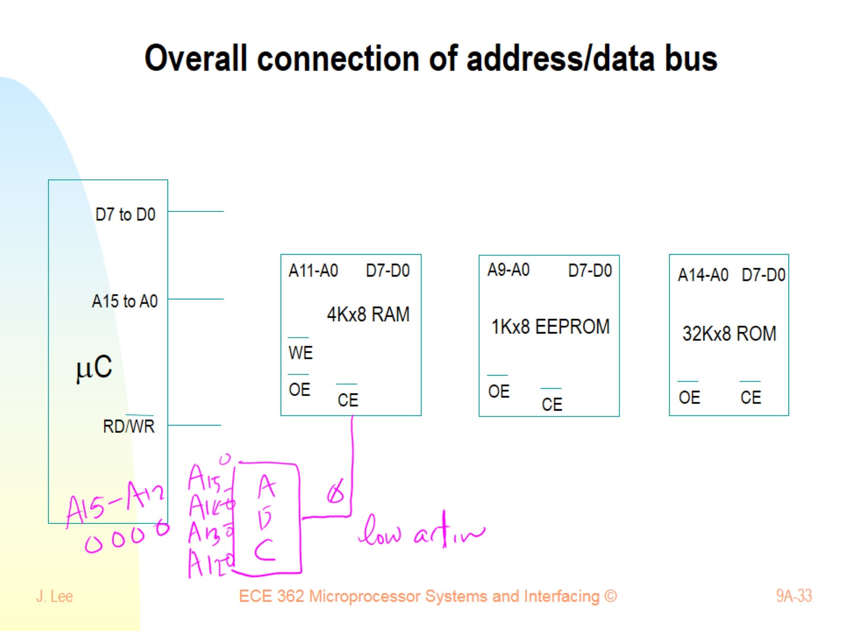
Overall connection of address/data bus

Slide 34
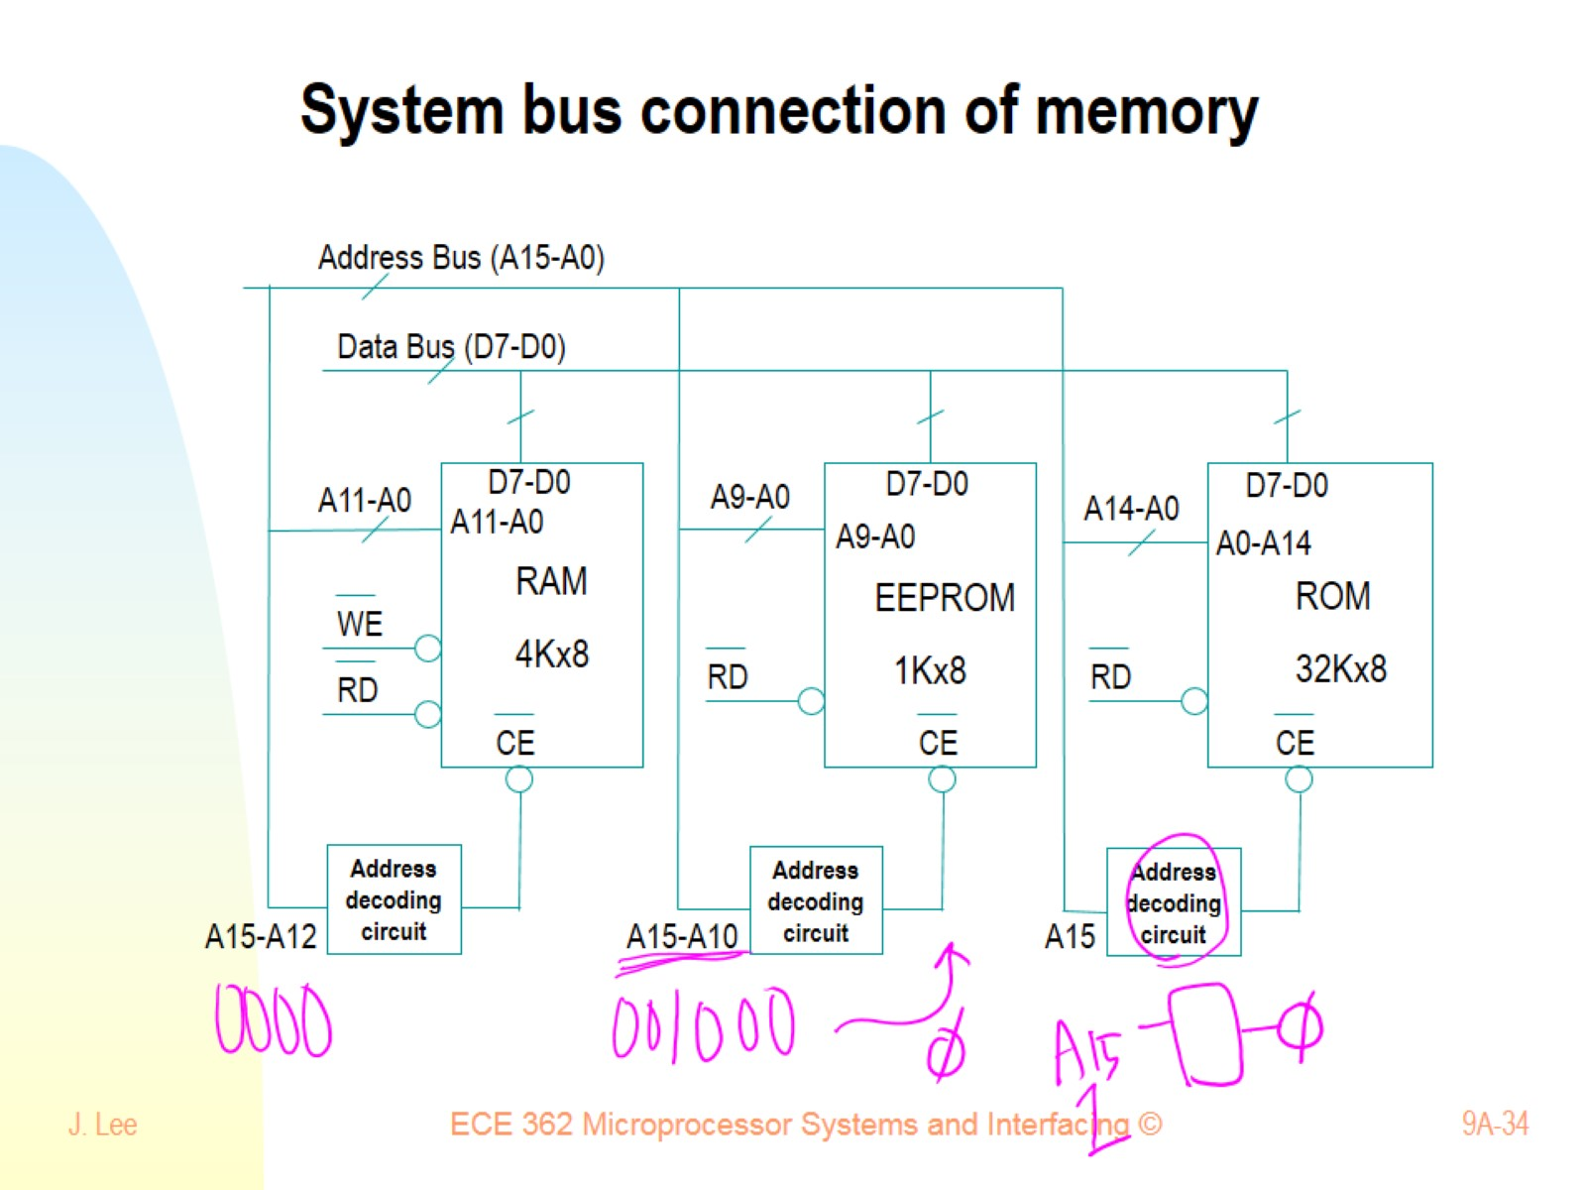
System bus connection of memory

Slide 35
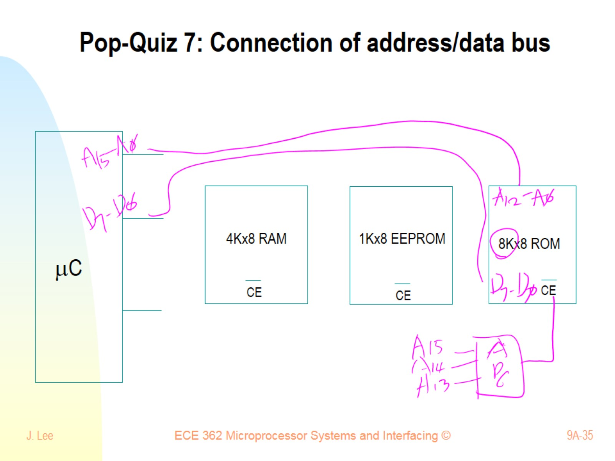
Pop-Quiz 7: Connection of address/data bus

Slide 36
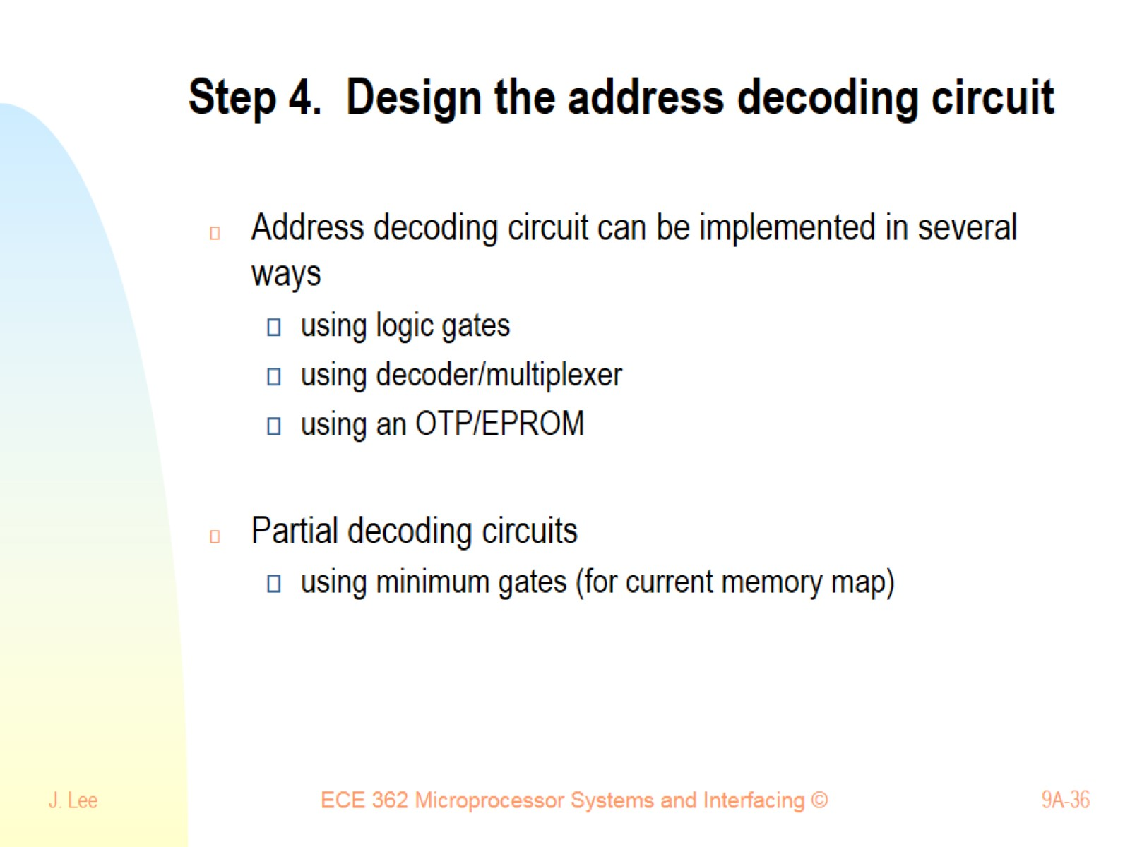
Step 4. Design the address decoding circuit

Slide 37
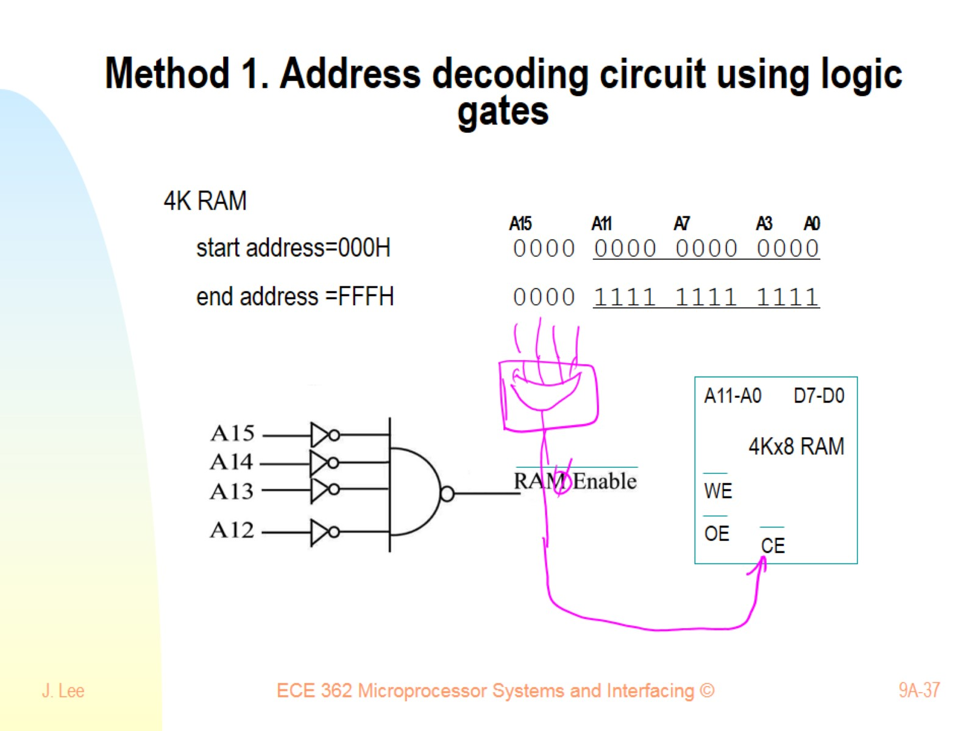
Method 1. Address decoding circuit using logic gates

Slide 38
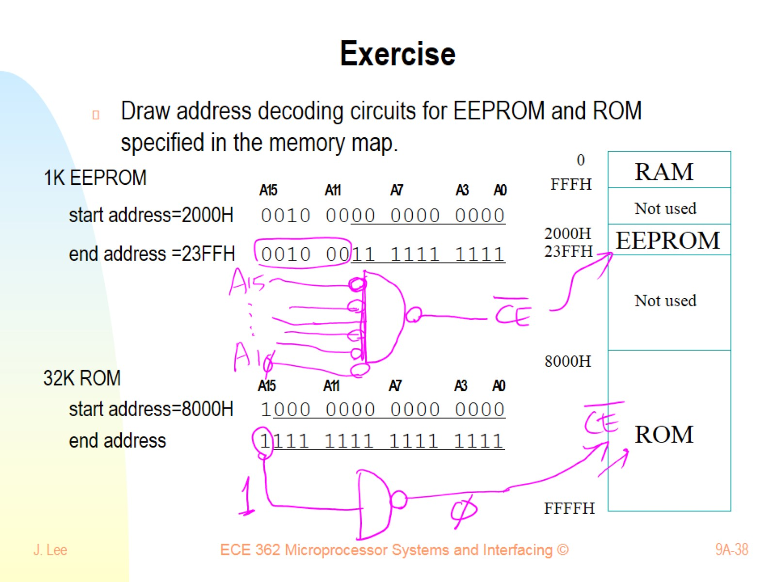
Exercise

Slide 39
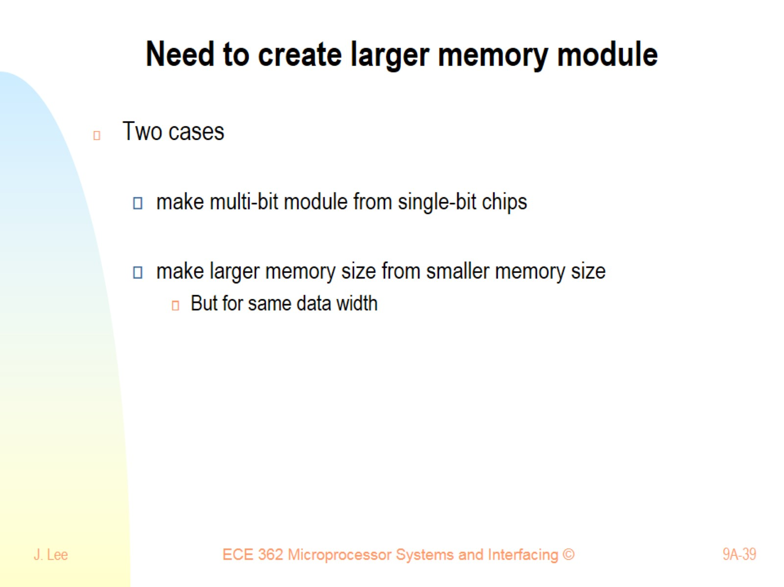
Need to create larger memory module

Slide 40
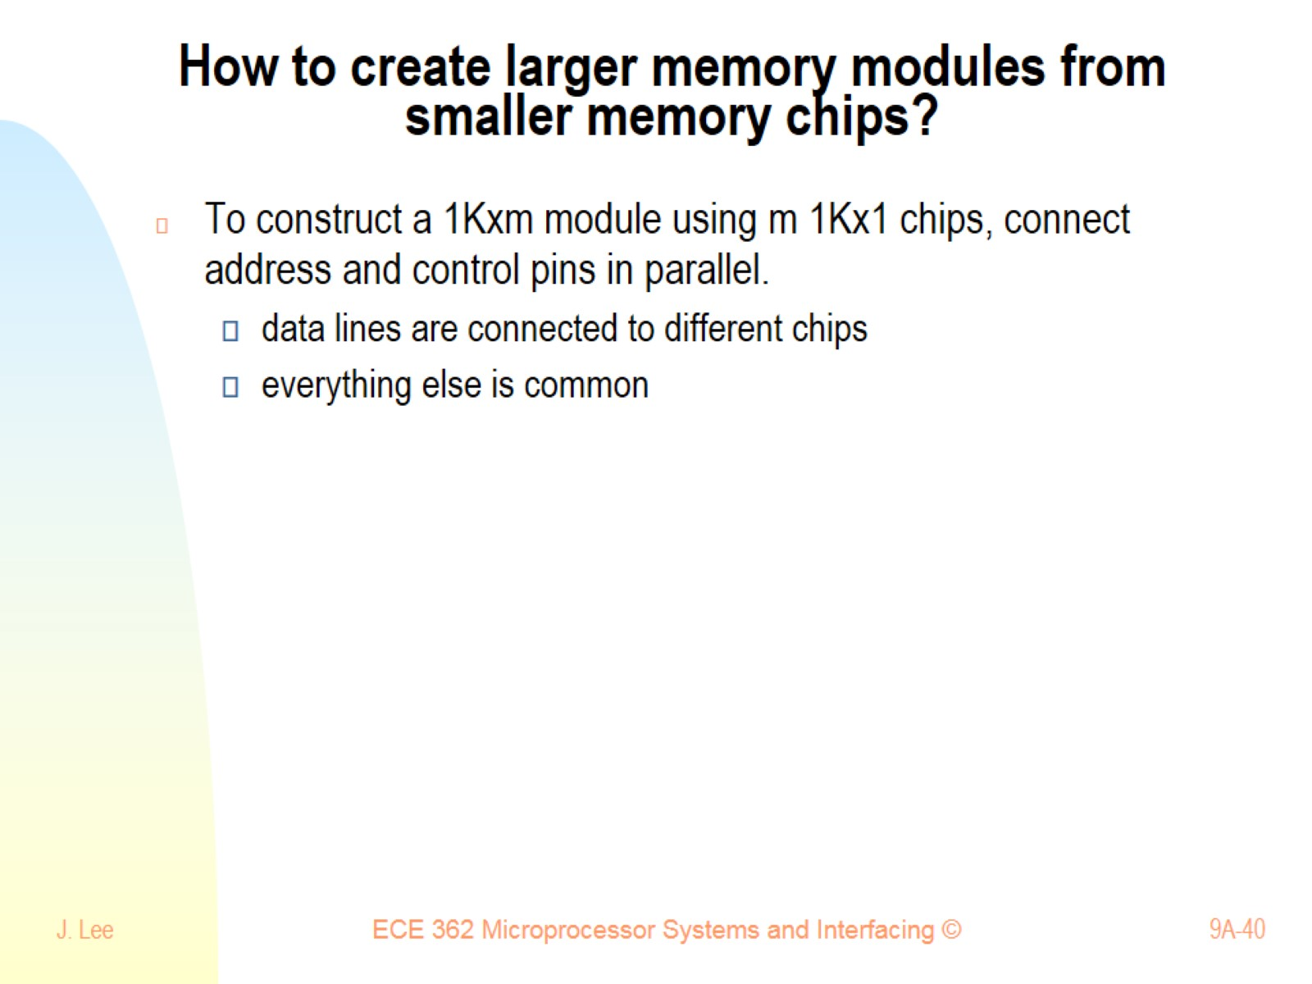
How to create larger memory modules from smaller memory chips?

Slide 41
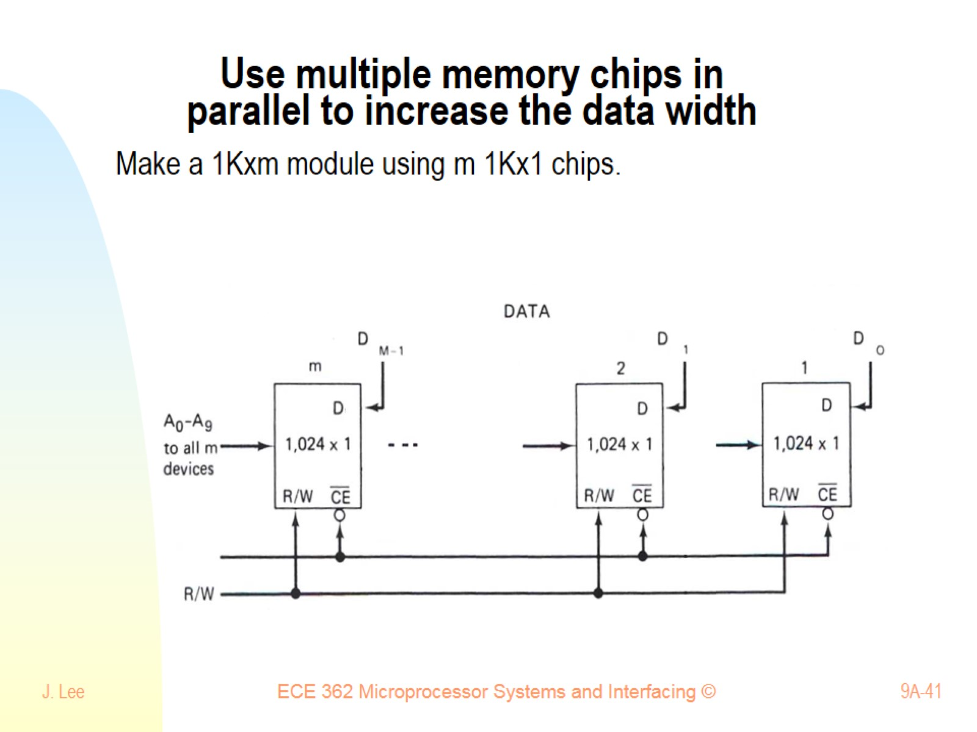
Use multiple memory chips in parallel to increase the data width

Slide 42
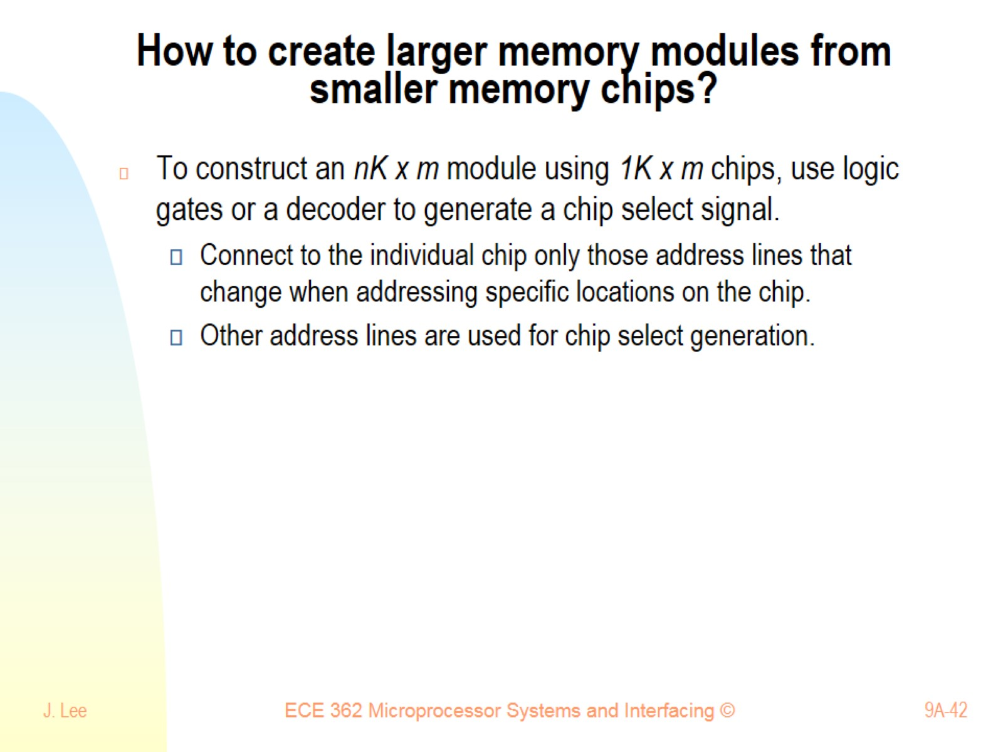
How to create larger memory modules from smaller memory chips?

Slide 43
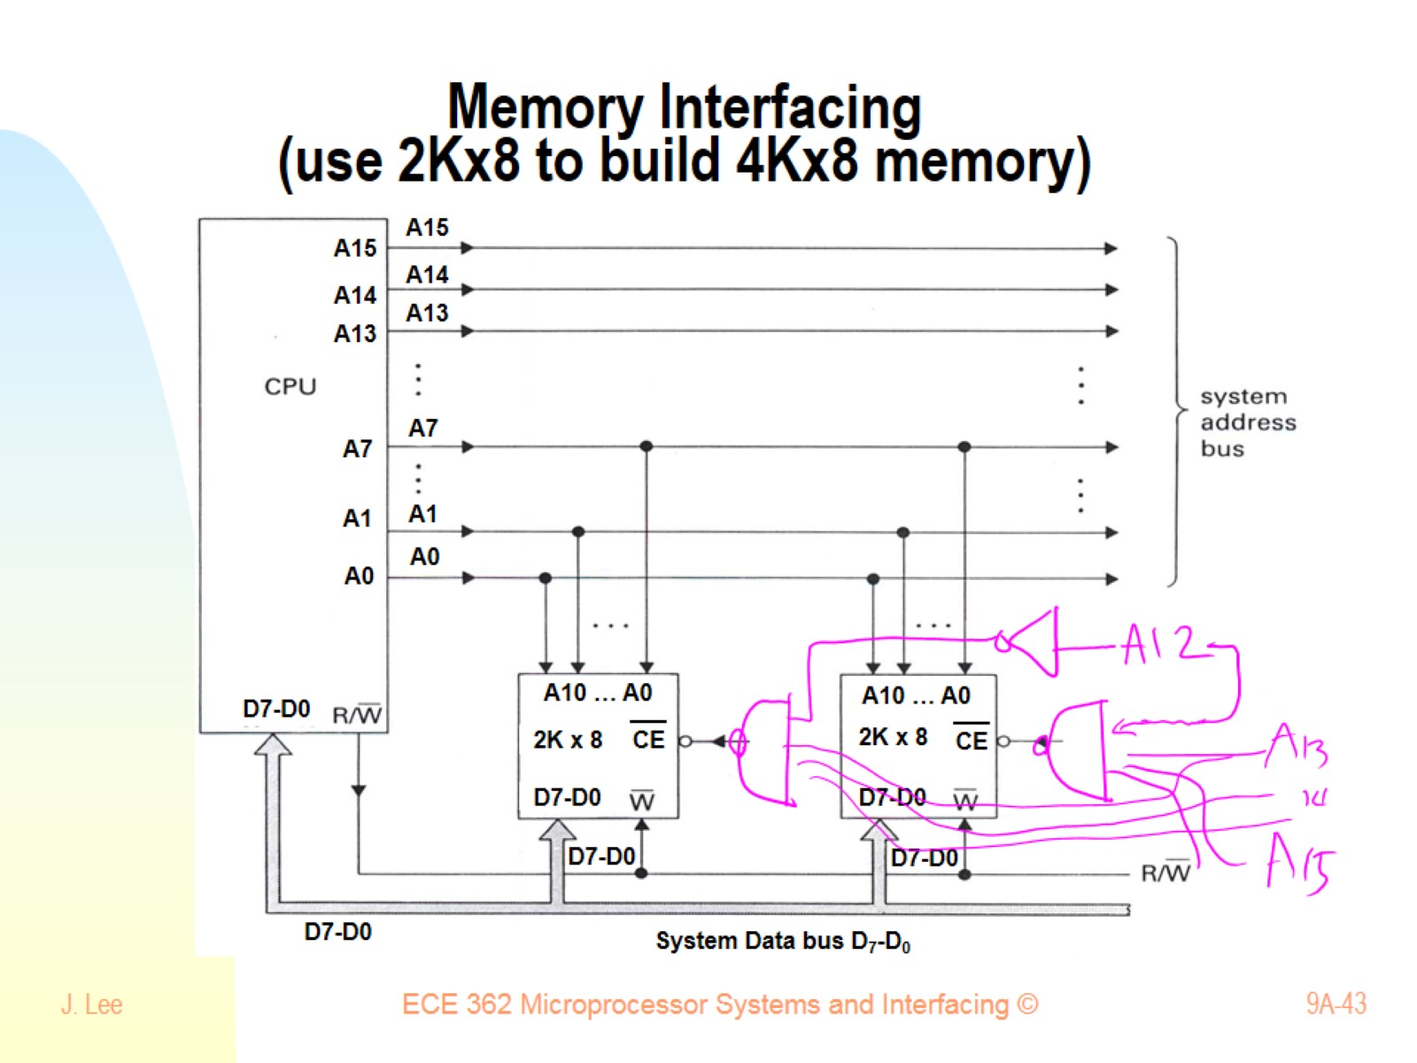
Memory Interfacing (use 2Kx8 to build 4Kx8 memory)

Slide 44
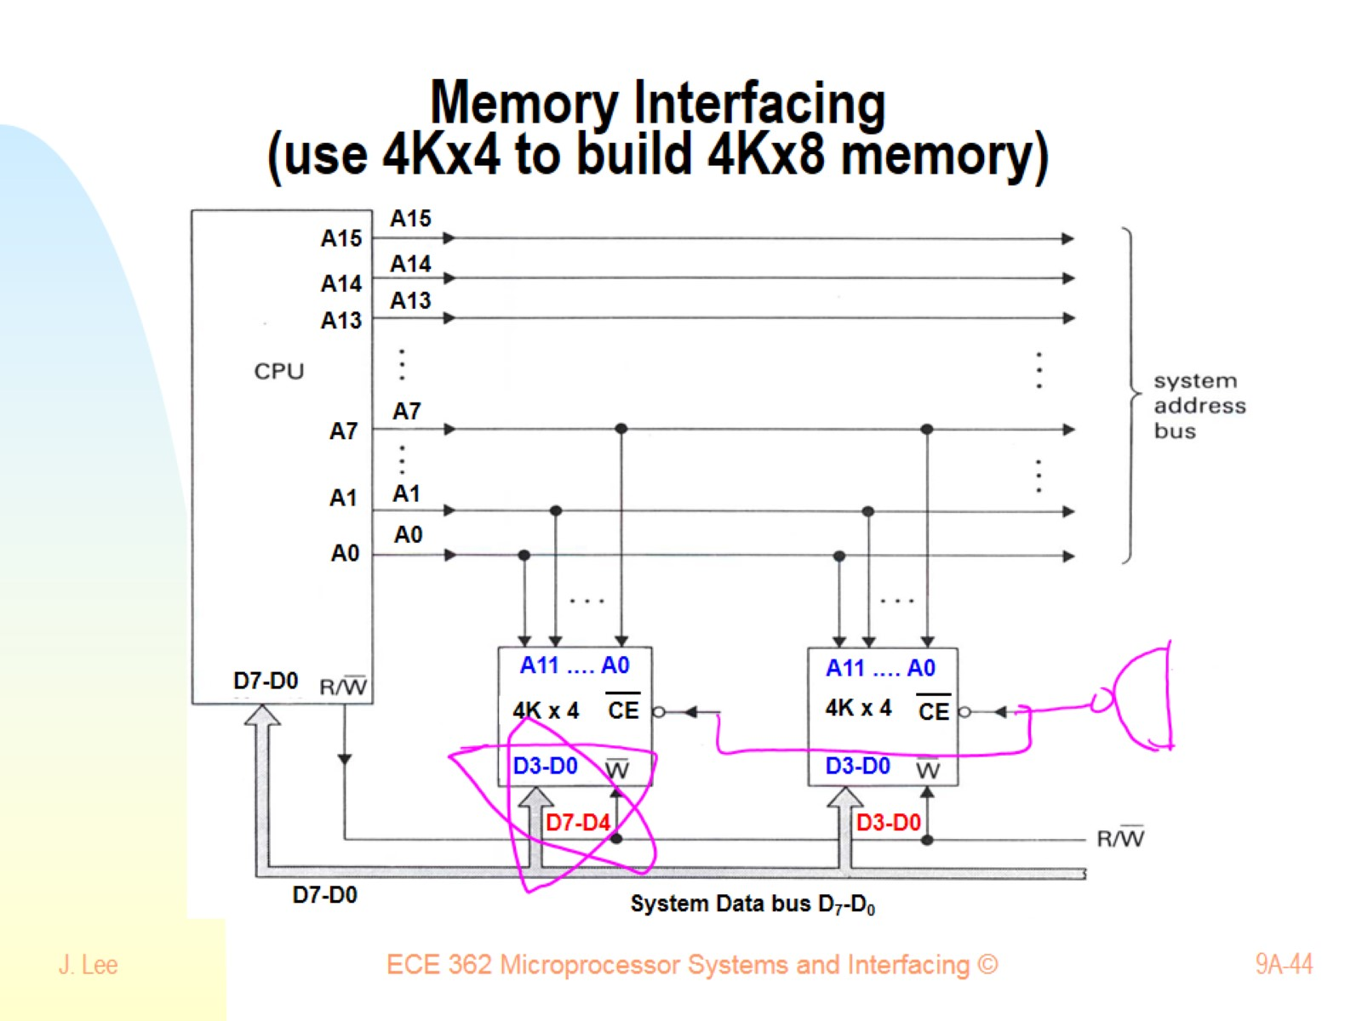
Memory Interfacing (use 4Kx4 to build 4Kx8 memory)

Slide 45
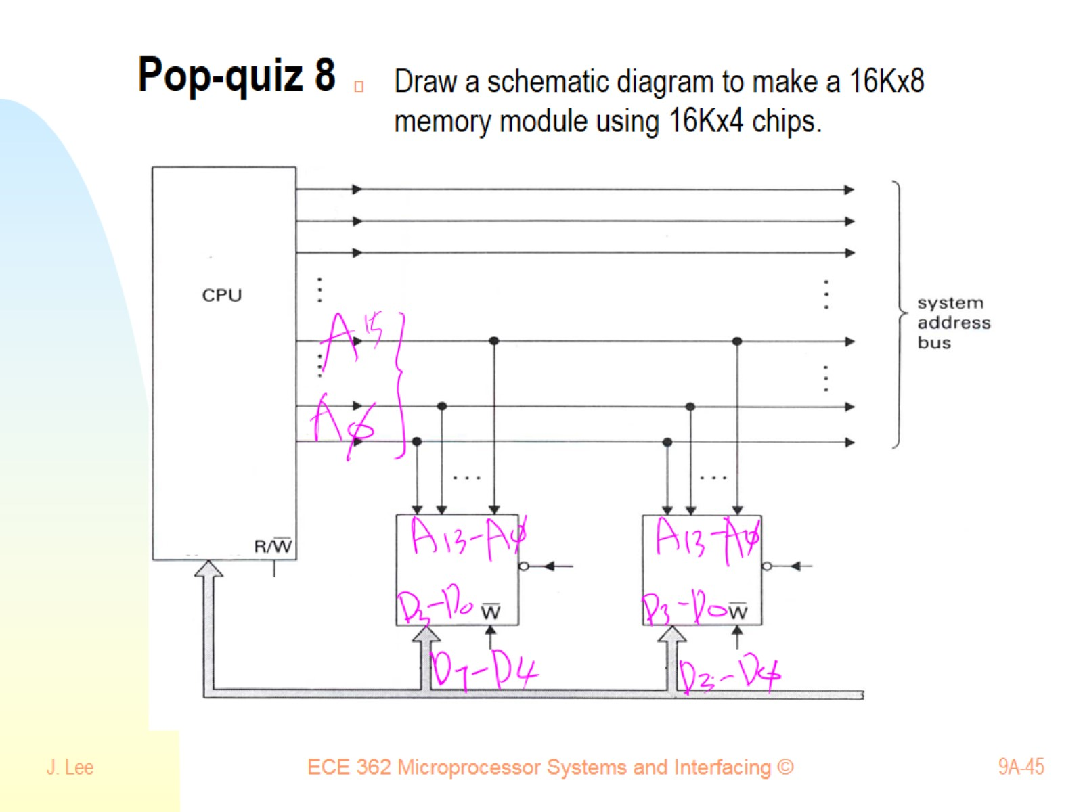
Pop-quiz 8

Slide 46
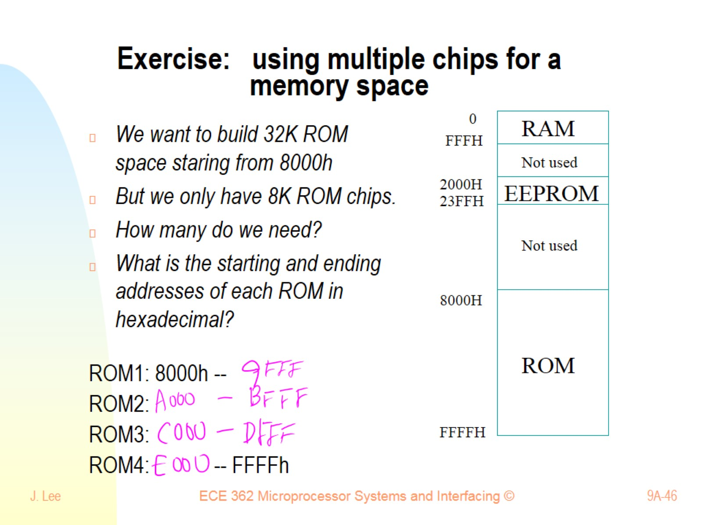
Exercise: using multiple chips for a memory space

Slide 47
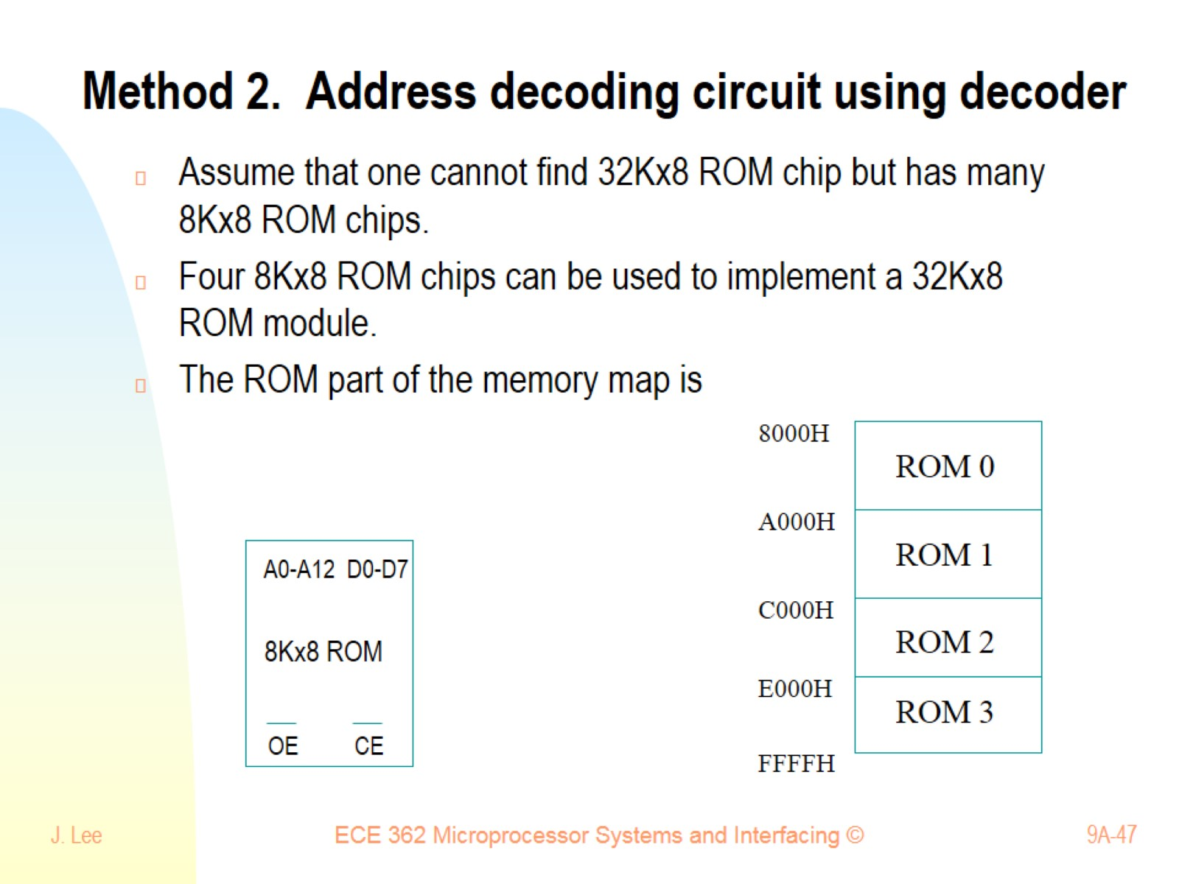
Method 2. Address decoding circuit using decoder

Slide 48
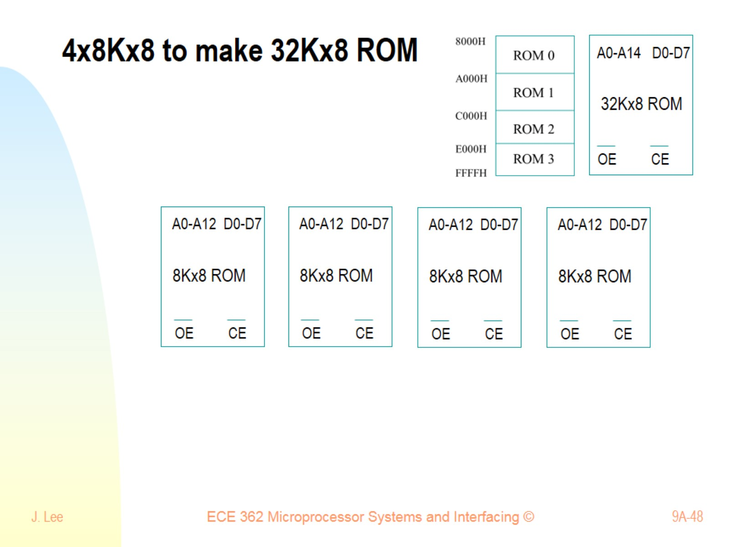
4x8Kx8 to make 32Kx8 ROM

Slide 49
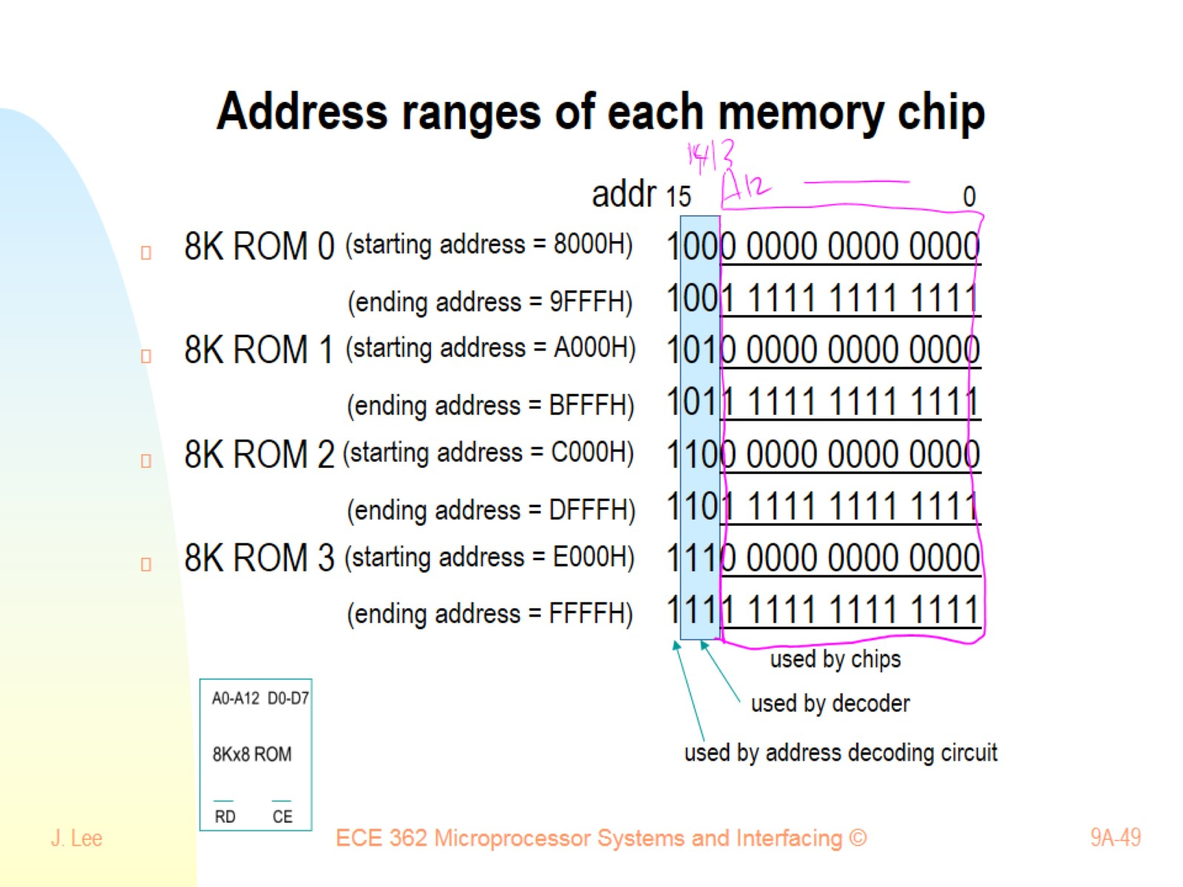
Address ranges of each memory chip

Slide 50
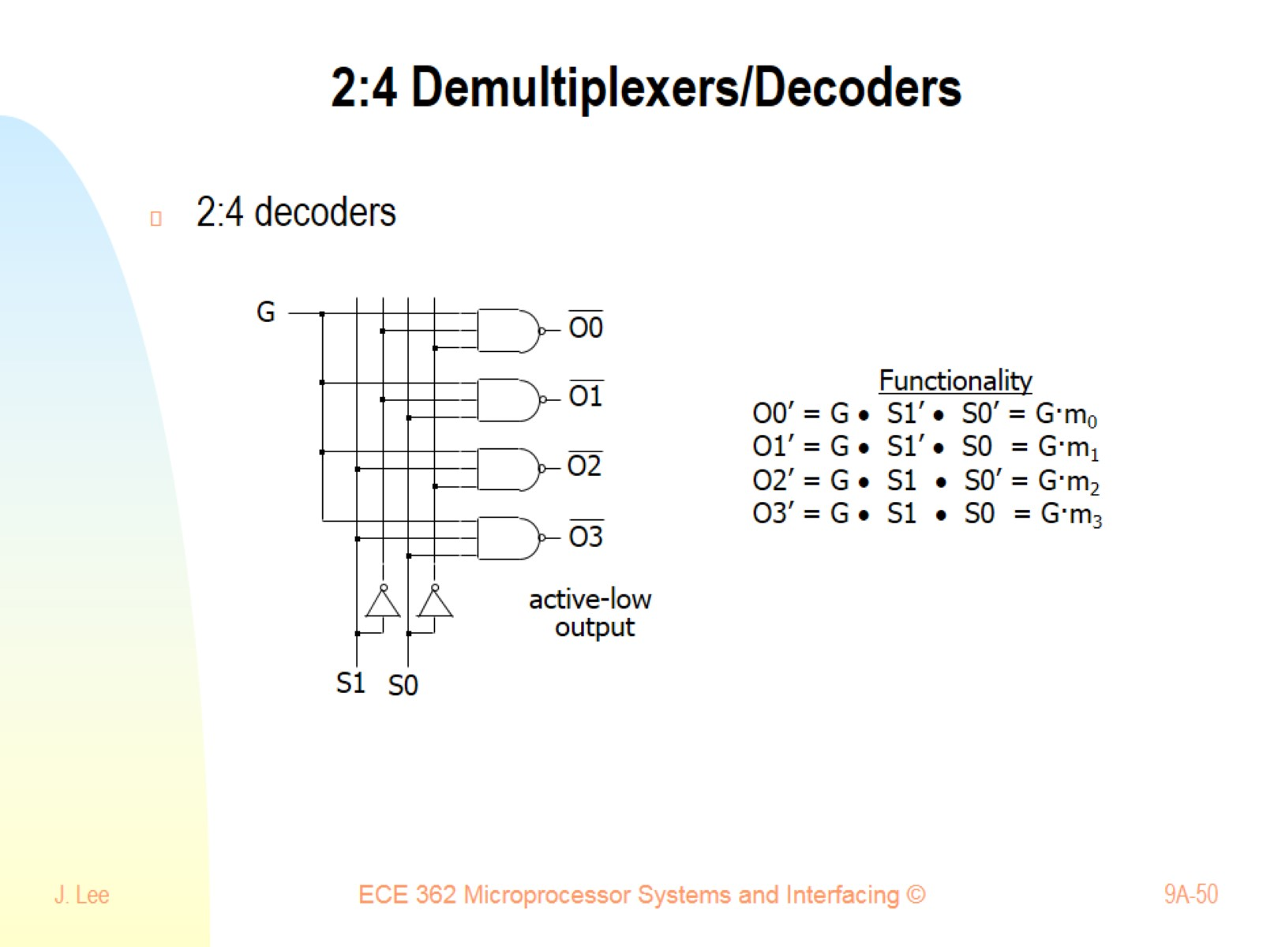
2:4 Demultiplexers/Decoders

Slide 51

Address decoding circuit using decoder

Slide 52

Observation in Address Decoding Circuit

Slide 53

When you need many address decoding circuits

Slide 54

Concept of CE Generation using a ROM

Slide 55

ROM 101: Base is Decoder

Slide 56

ROM 101: 1-bit ROM

Slide 57

4-bit ROM, also 4-output Combinational Logic

Slide 58

Gate vs. ROM

Slide 59

Granularity for each min-term

Slide 60

Granularity for each min-term

Slide 61

Granularity and Coverage

Slide 62

Pop-Quiz 9

Slide 63

Final Design (Addr. Decoding Circuit using ROM)

Slide 64

Method 3. Address decoding circuit using ROM

Slide 65

Method 3. Address decoding circuit using ROM

Slide 66

Partial address decoding

Slide 67

Partial address decoding example

Slide 68

Exercise:

Slide 69

Exercise:

Slide 70

Exercise: Interface memory chips to buses

Slide 71

Exercise: Interface memory chips to buses

Slide 72

Exercise: Interface memory chips to buses

Slide 73

Exercise: Partial Decoding Example

